Slide 1
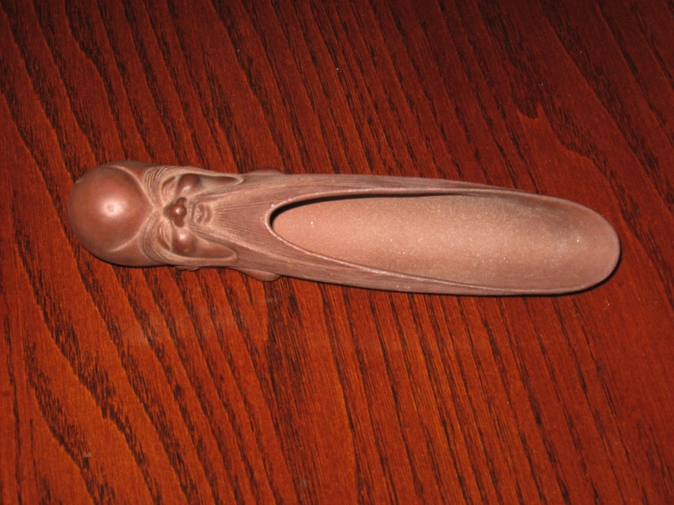
Artifact—Chinese Tea Scoop

Slide 2
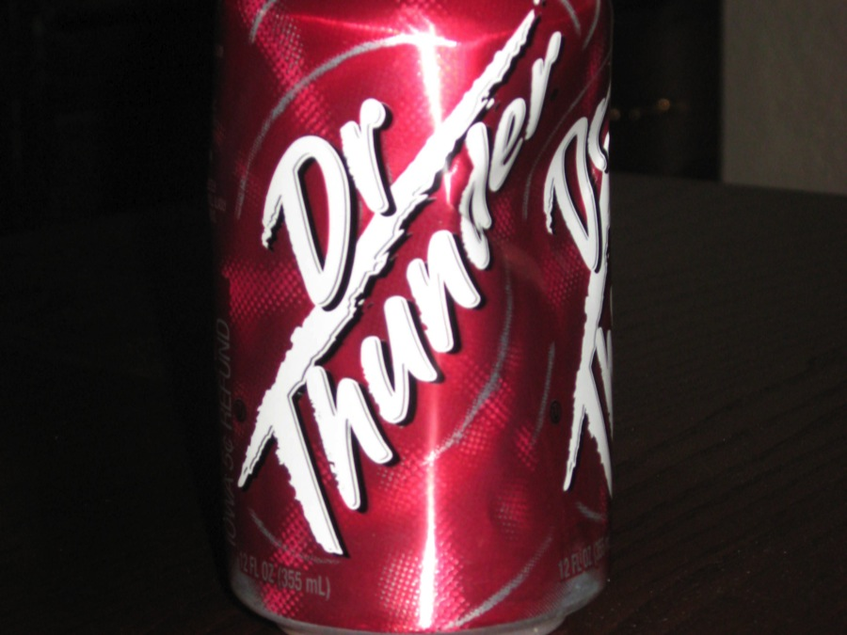
Artifact (Soda Can)

Slide 3
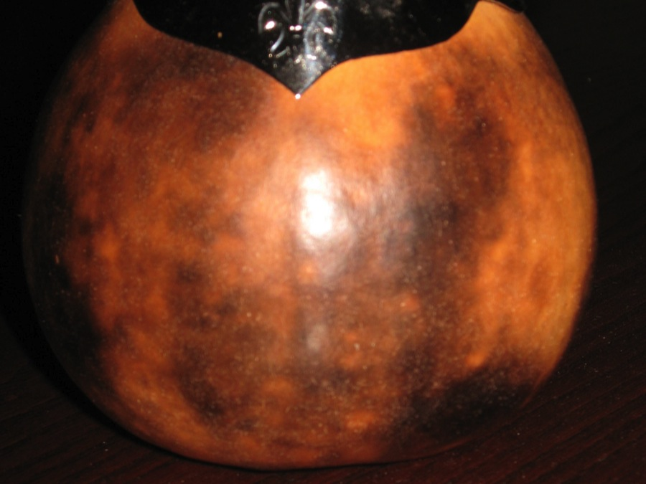
Artifact—Mate Cup

Slide 4
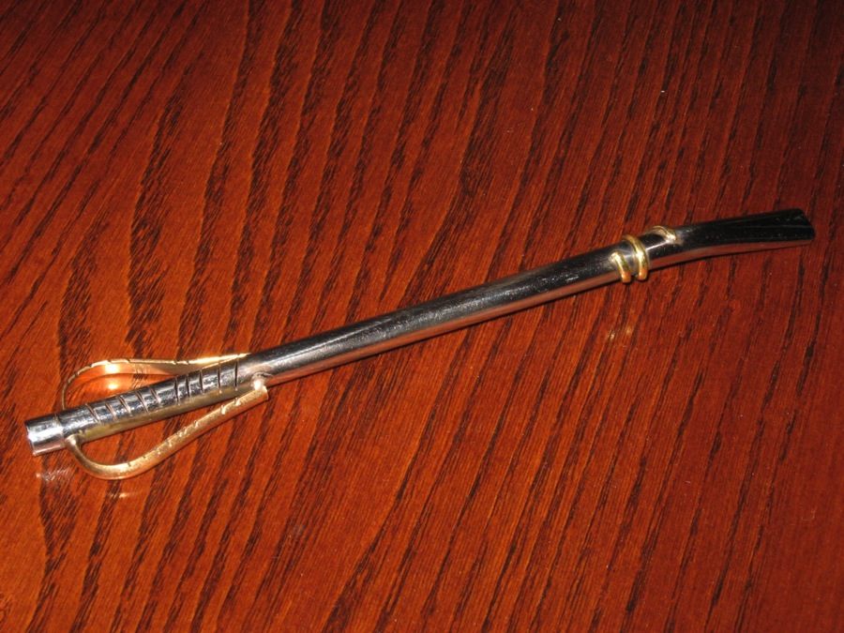
Artifact—Bombilla

Slide 5
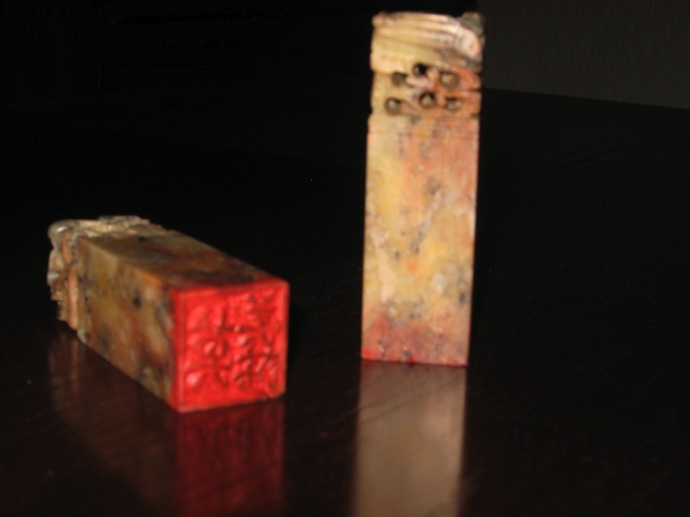
Artifact—Chinese Chop

Slide 6
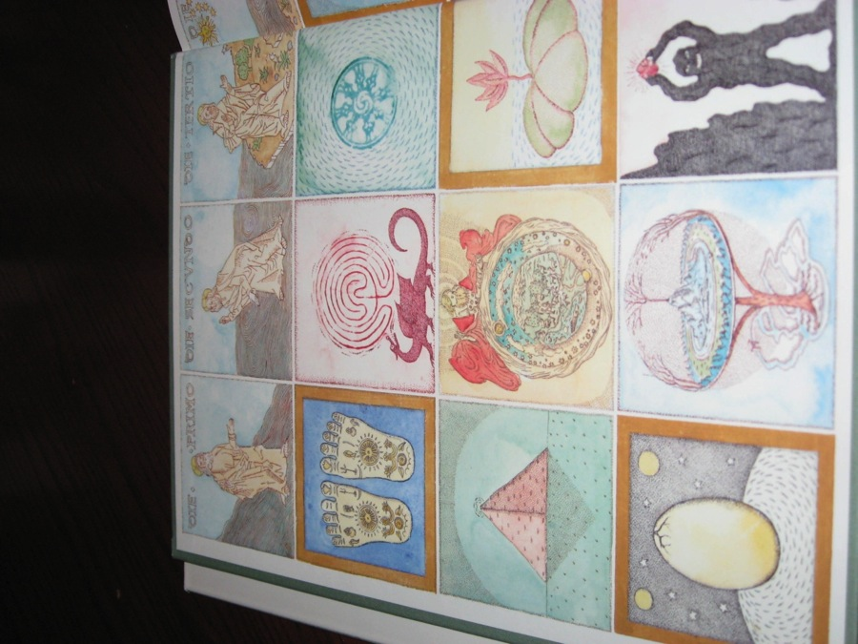
Artifact—Fly page

Slide 7
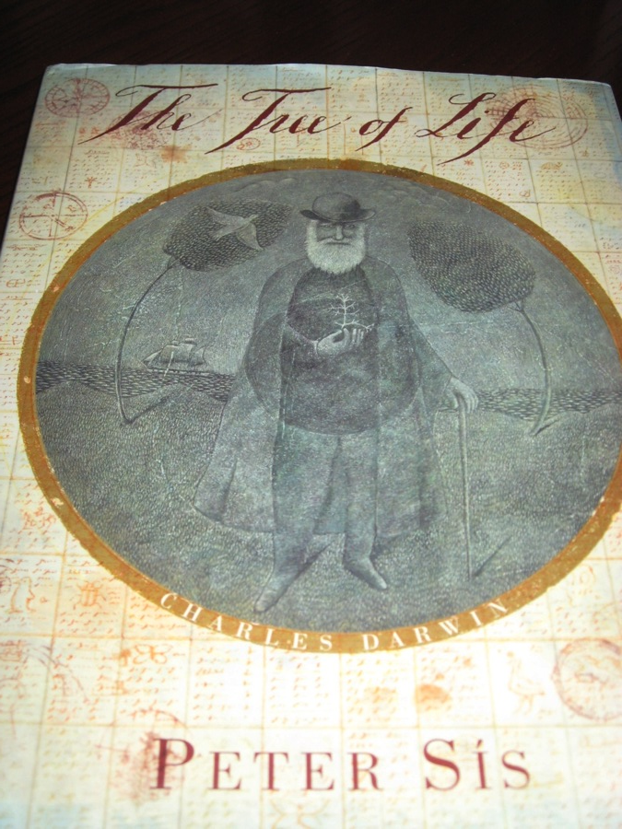
Book cover

Slide 8
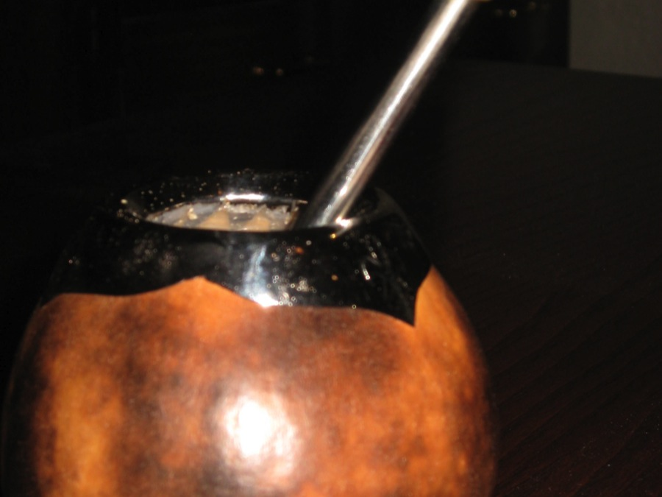
Mate and Bombilla

Slide 9
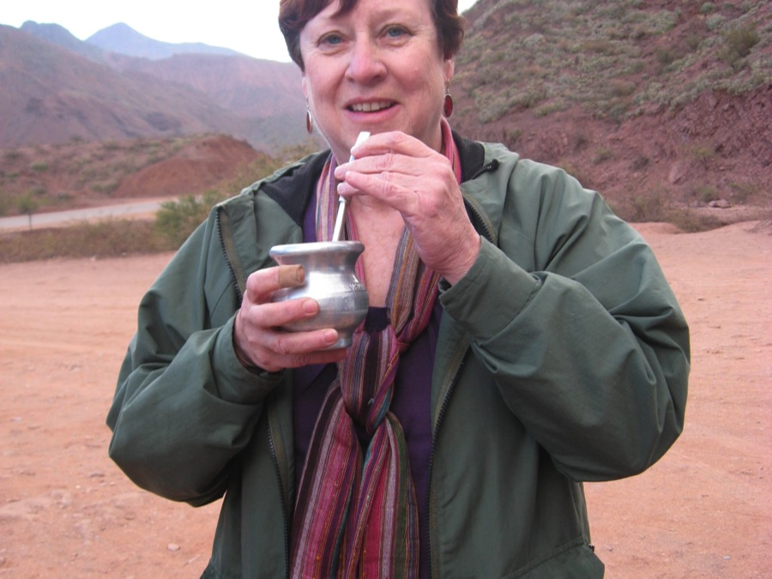
Enjoying Mate in Salta Province

Slide 10
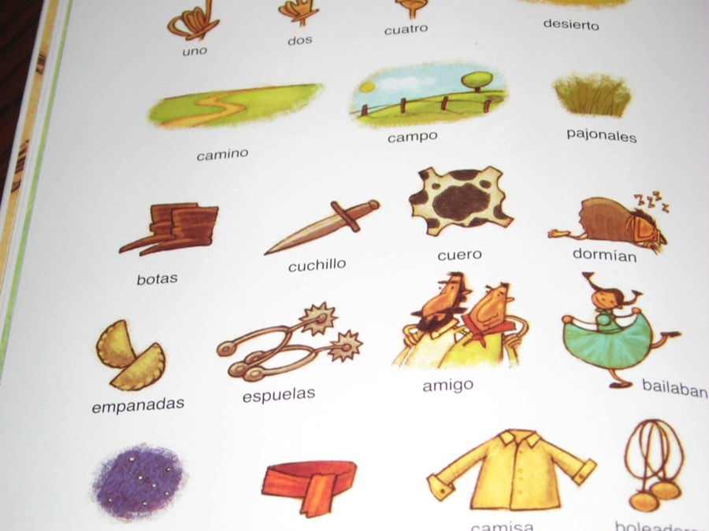
Diccionario—La Historia del Gaucho Martin Fierro

Slide 11
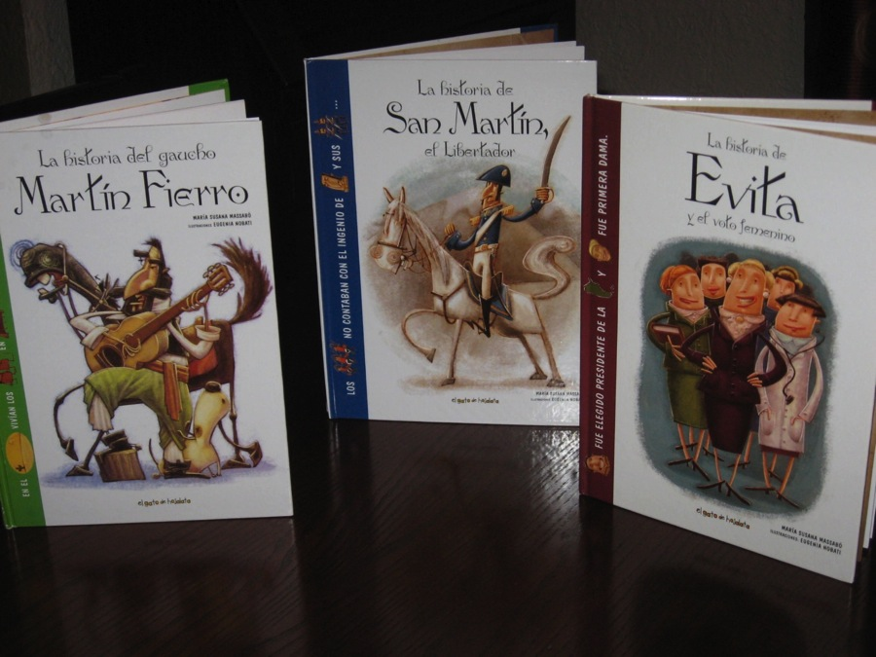

Slide 12
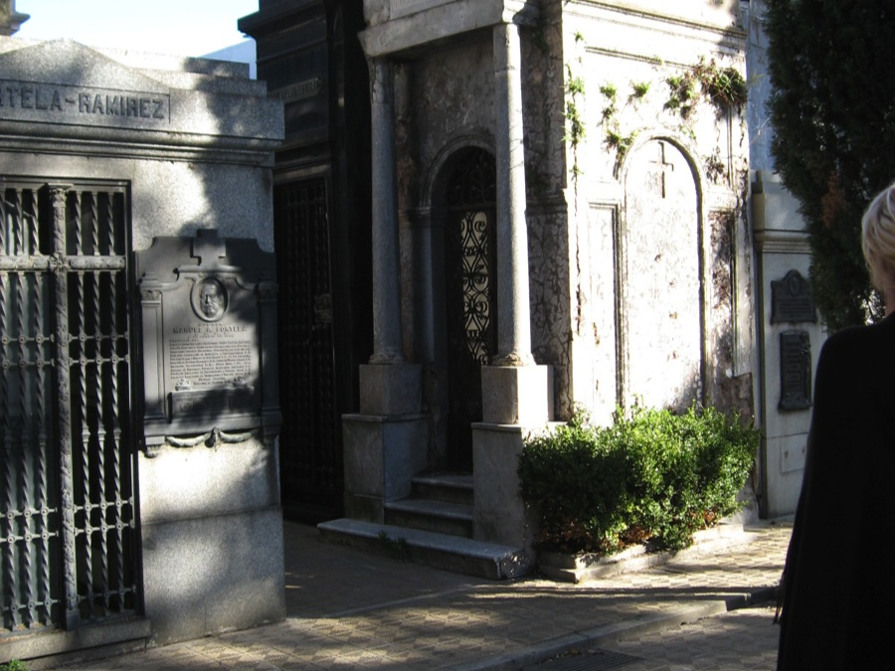
Recoleta Cemetery, Buenos Aires

Slide 13
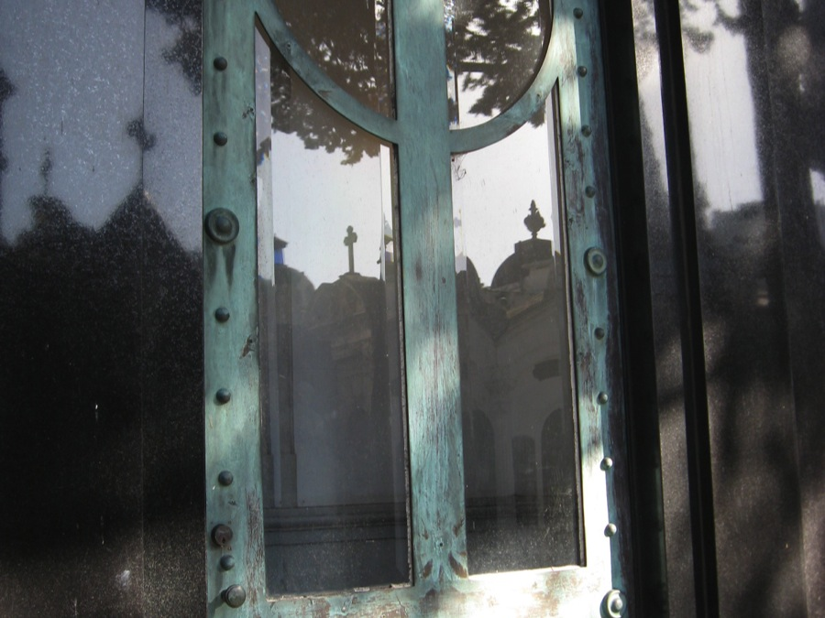
Reflections at Recoleta Cemetery

Slide 14
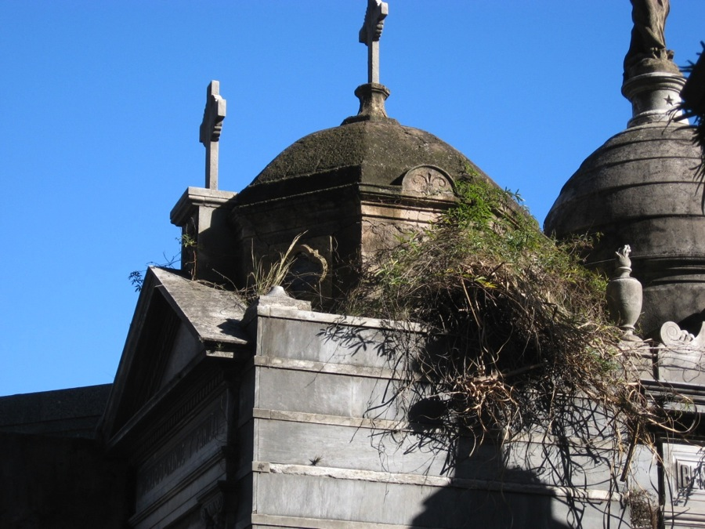
Recoleta Cemetary

Slide 15
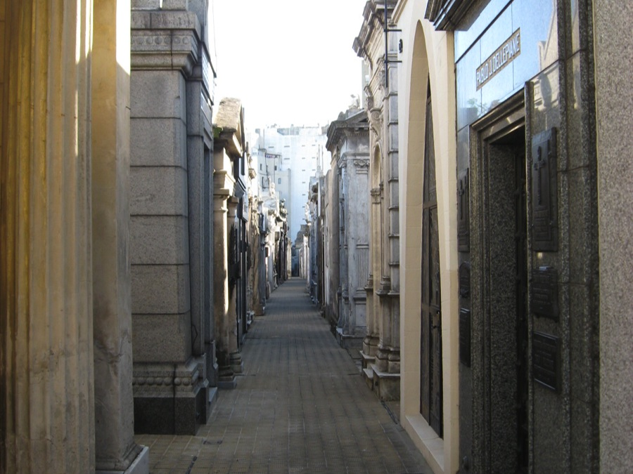
Mausoleums

Slide 16
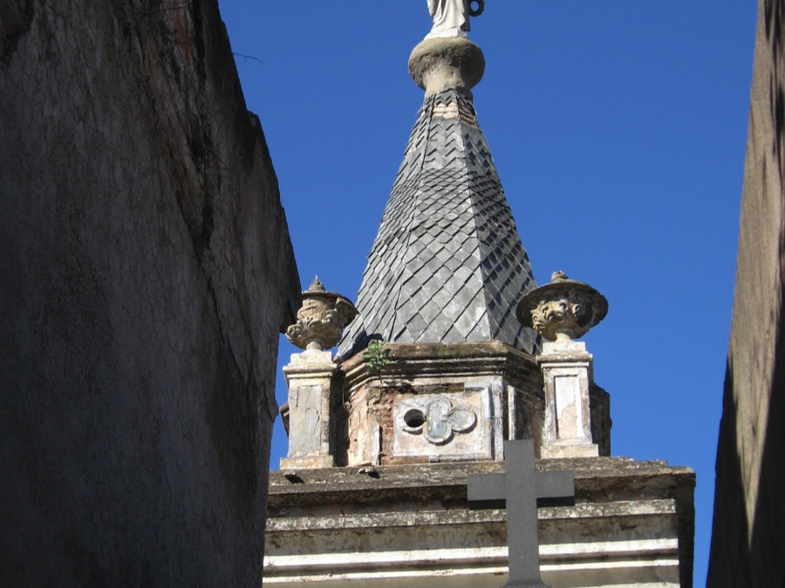
Architecture at Recoleta Cemetery

Slide 17
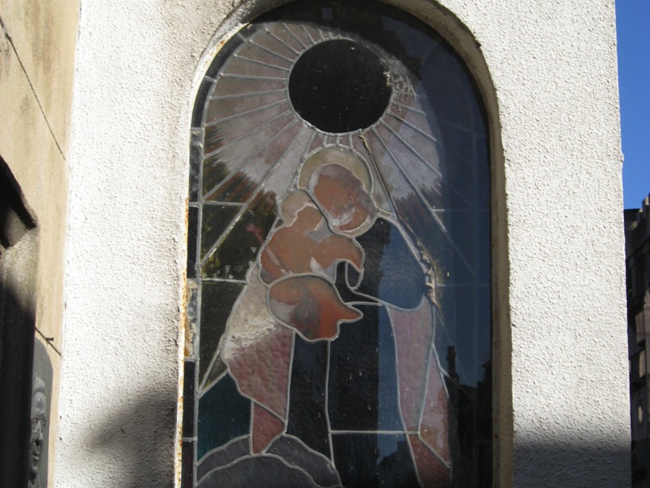
Stained glass detail of Mausoleum

Slide 18
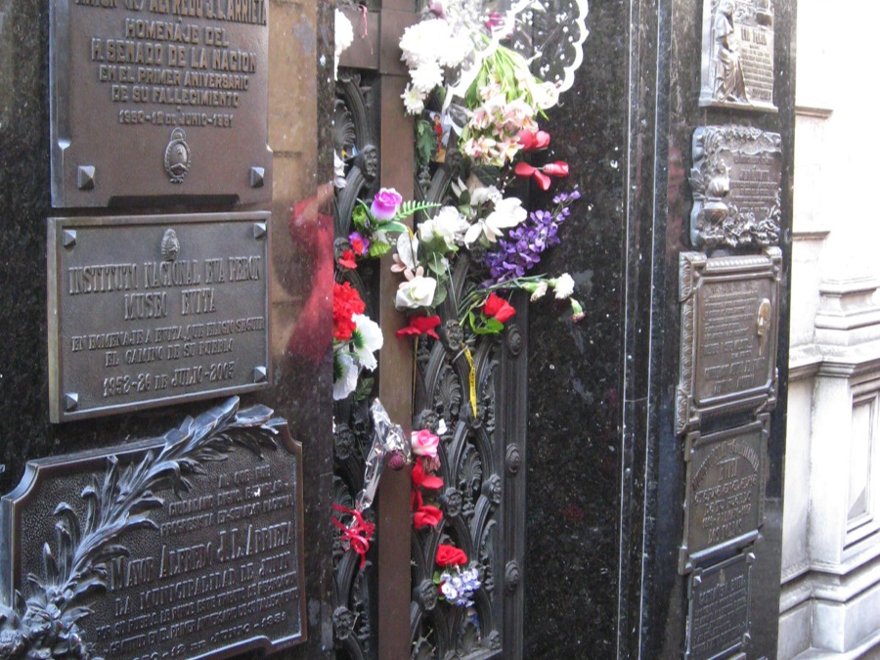
Duarte Family Mausoleum, Recoleta Cemetery

Slide 19
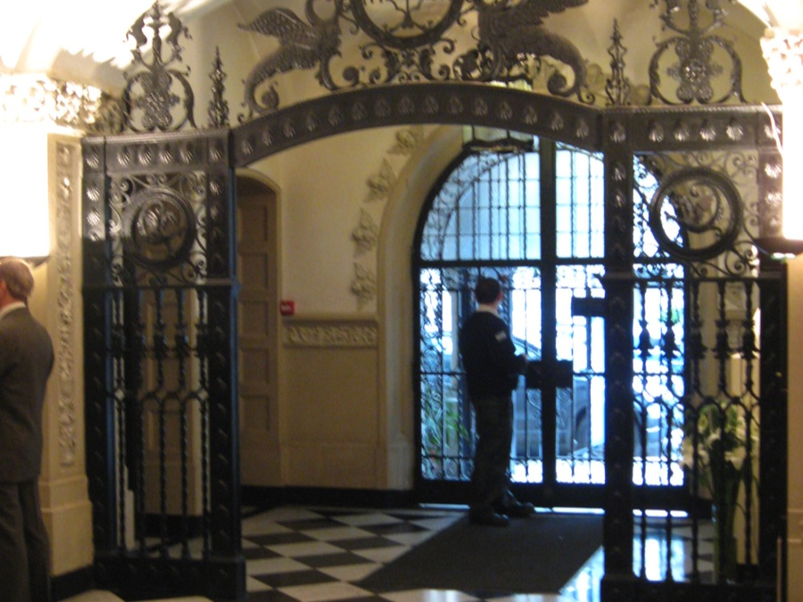
Reception area at Evita Museum, Buenos Aires

Slide 20
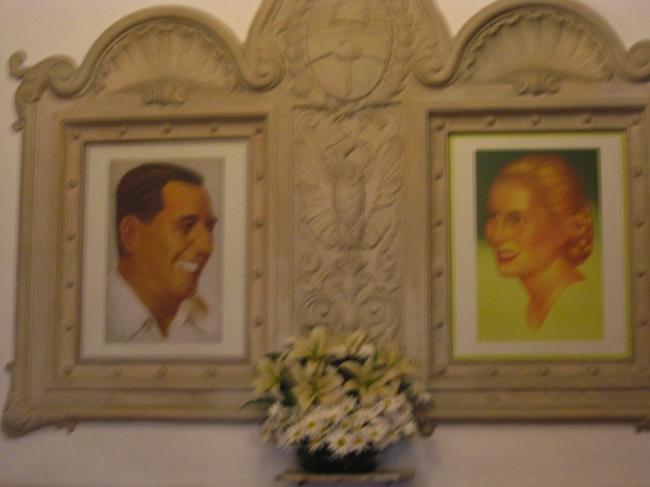
Juan Peron and Eva Peron (Evita)

Slide 21
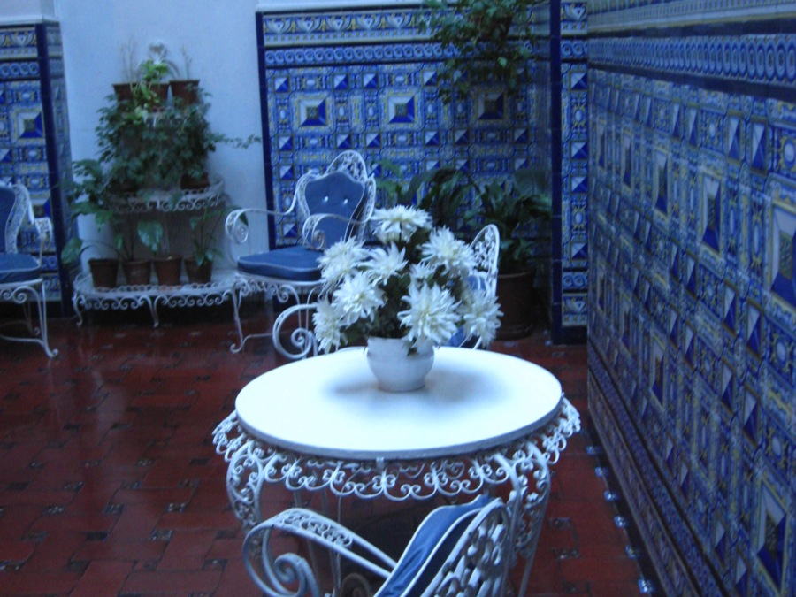
Interior, Evita Museum

Slide 22
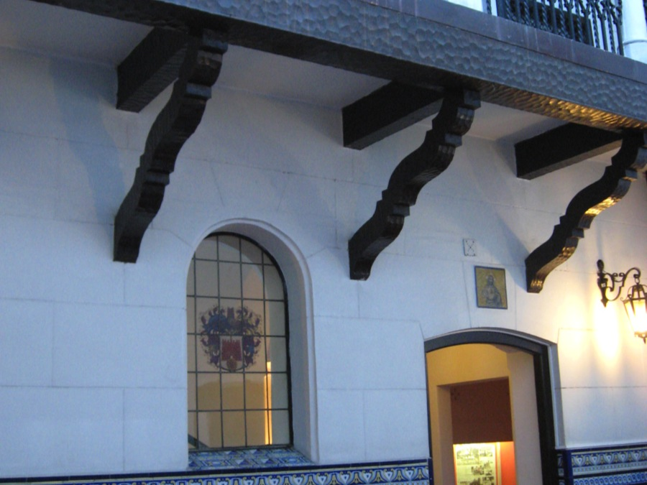
Interior Courtyard, Evita Museum

Slide 23
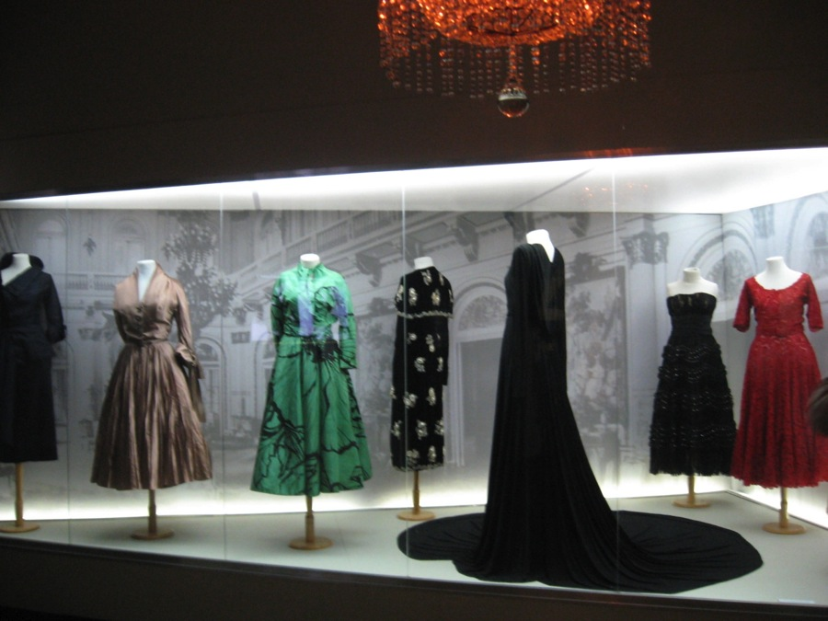
Dresses of Eva Peron

Slide 24
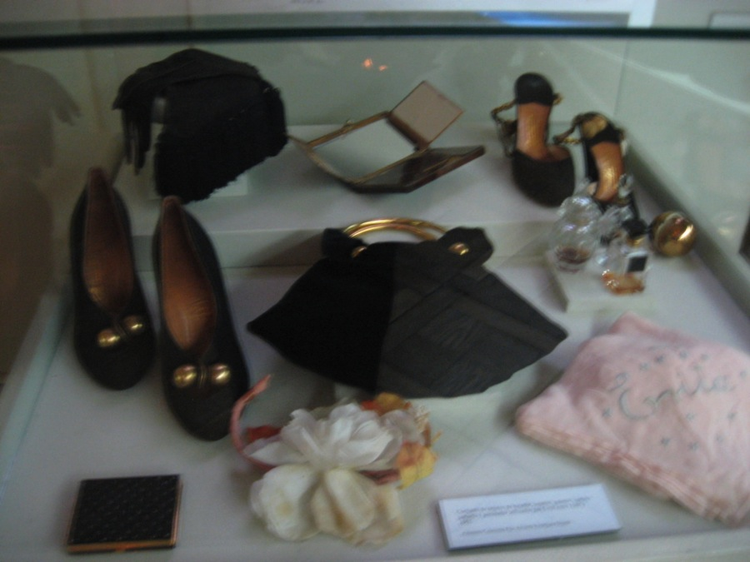
Shoes, Handbags and Accessories of Eva Peron

Slide 25
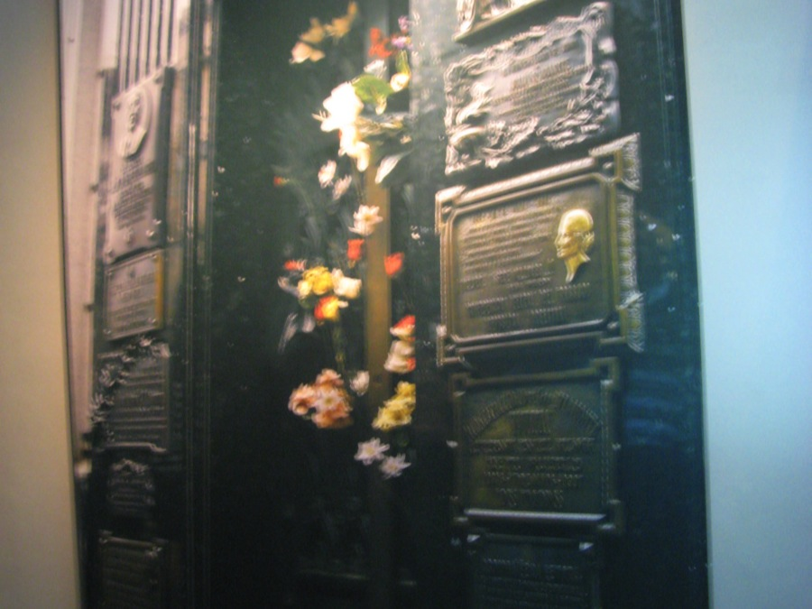
Replica of Duarte Family Mausoleum, Evita Museum

Slide 26
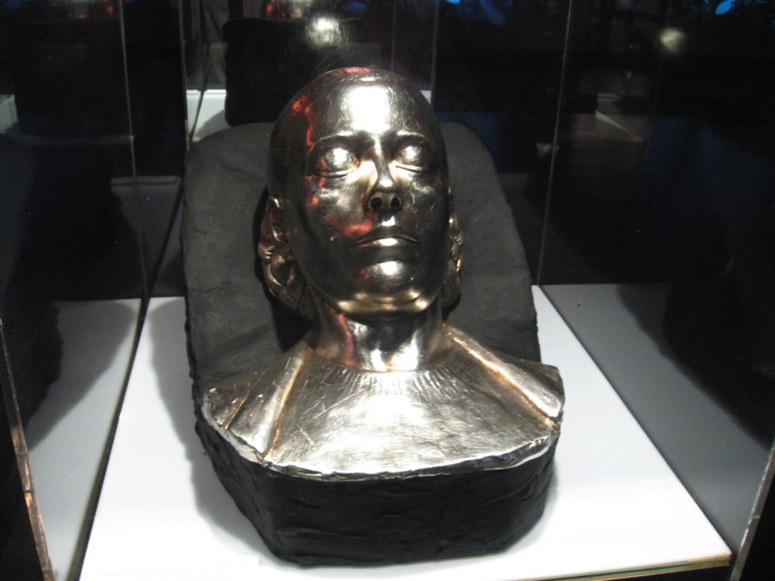
Effigy of Evita

Slide 27
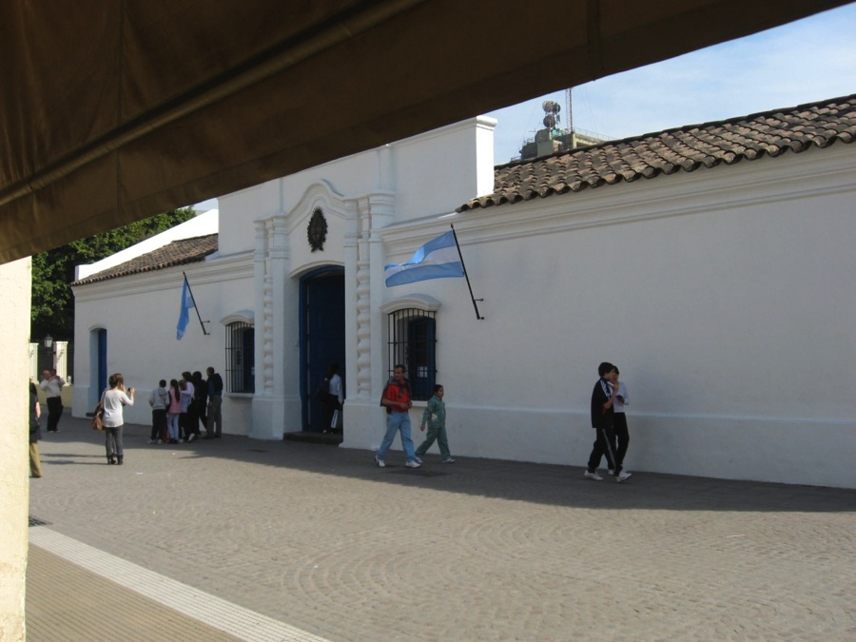
Casa Historica de la Independencia (Casa de Tucuman)

Slide 28
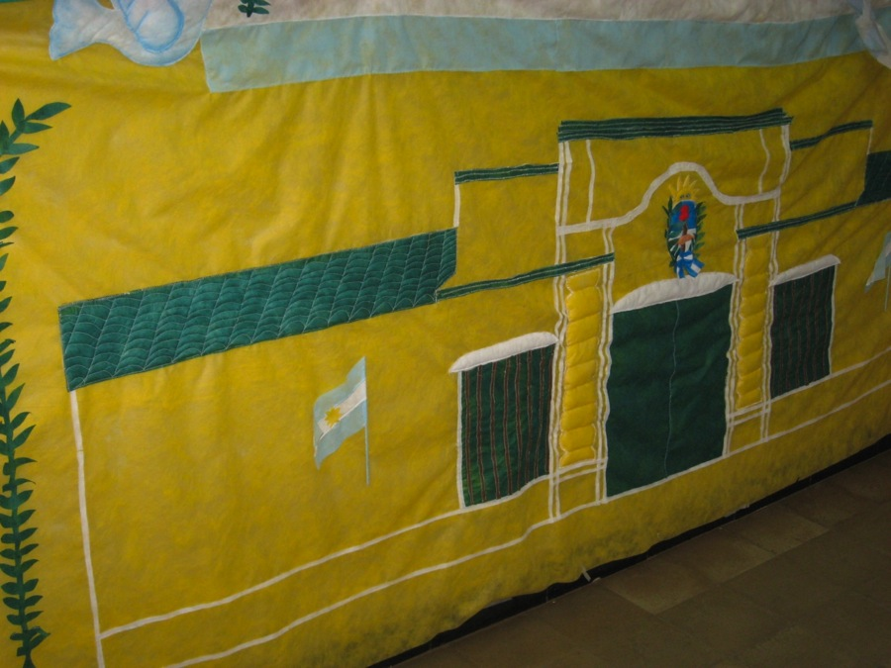
Casa Historica de la Independencia

Slide 29
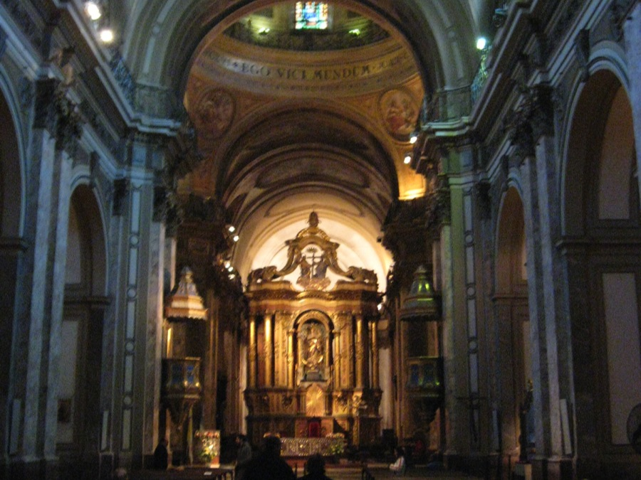
Buenos Aires Cathedral

Slide 30
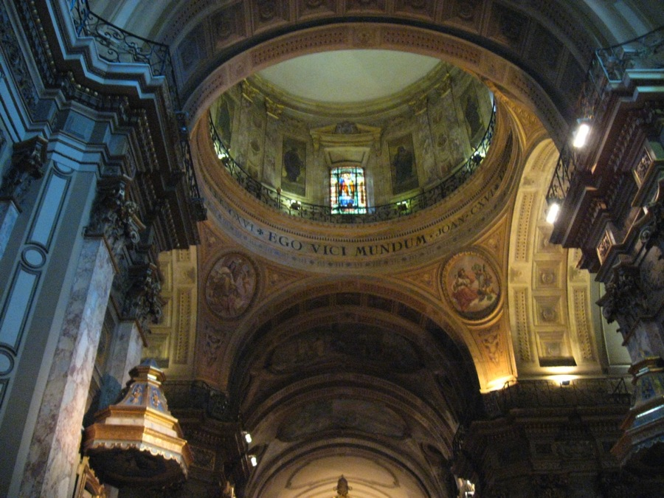
Buenos Aires Cathedral

Slide 31
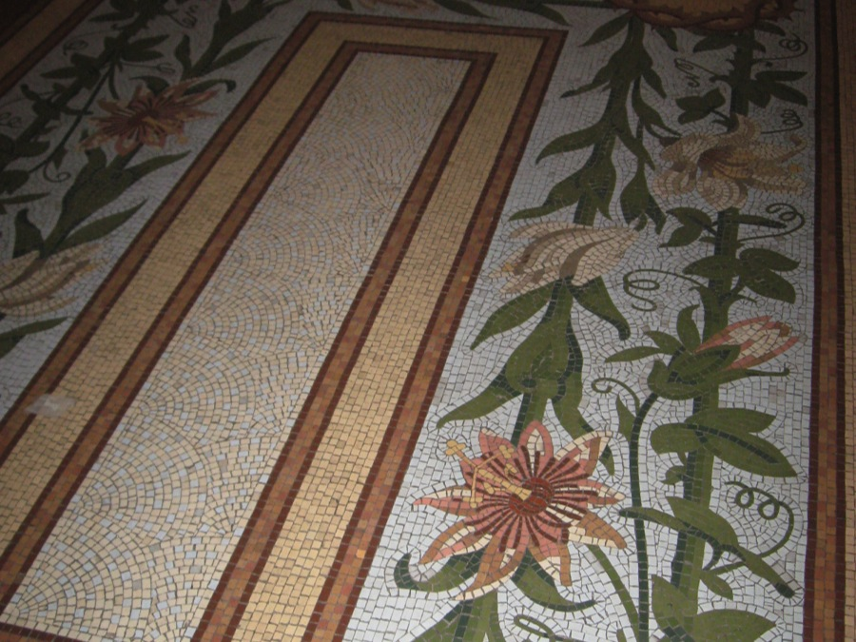
Mosaic tile file, B.A. Cathedral

Slide 32
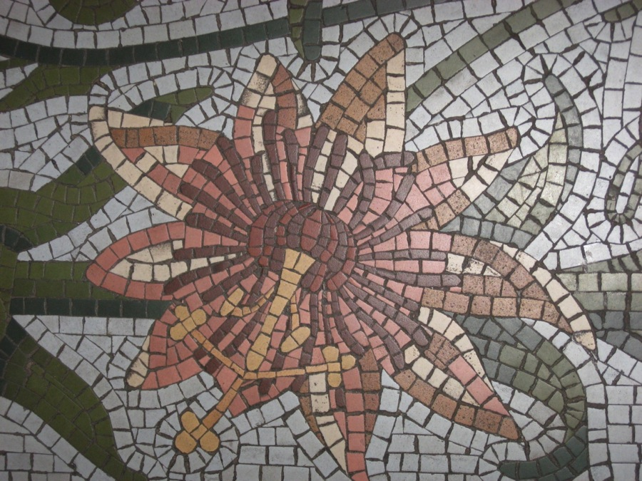
Mosaic detail

Slide 33
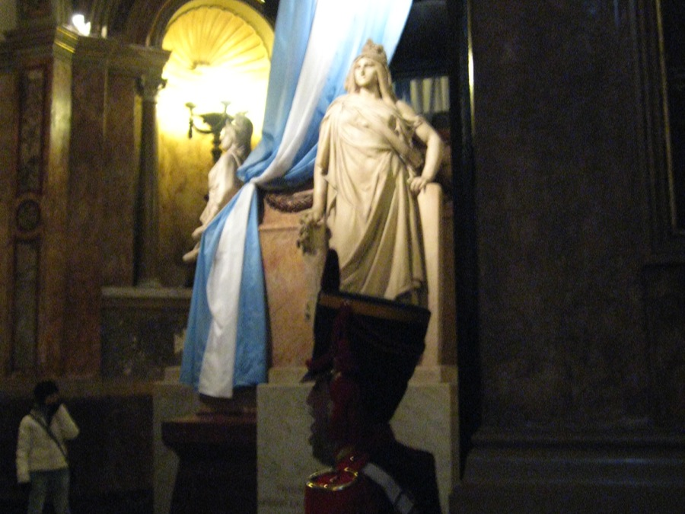
Tomb of San Martin, B.A. Cathedral

Slide 34
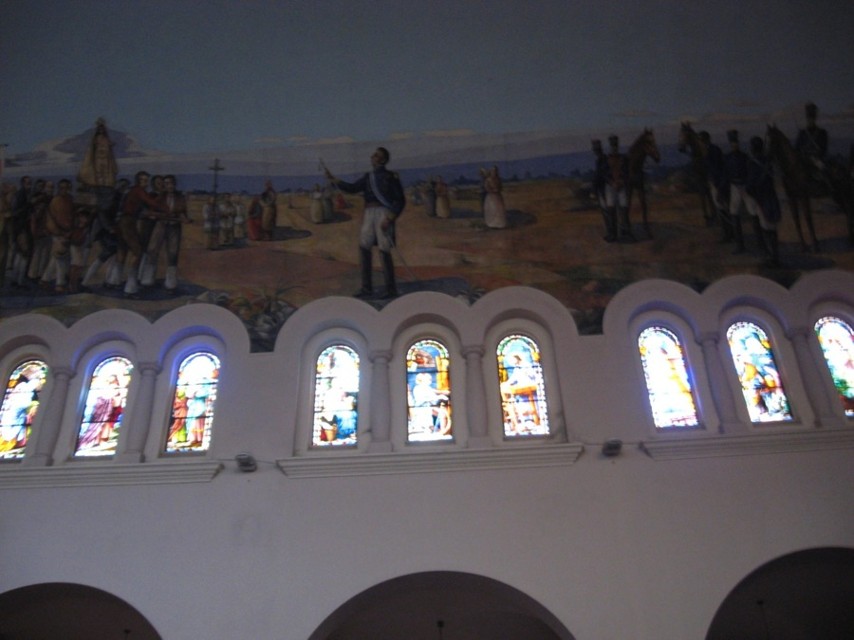
Interior, La Merced Church, Tucuman

