Slide 1
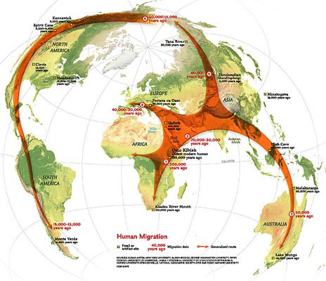
Human Migration

Slide 2
Objectives:
The student will identify and explain the different types of human migration.
The student will identify the categories of people who migrate and describe the differences among them.
The student will identify the reasons people move.

Slide 3
What is Human Migration?
Cues Notes
Human Migration the movement of people from one place to another

Slide 4
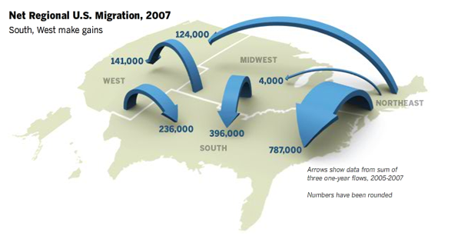
What are the different types of human migration?
Cues Notes
Internal Migration moving within a state, country, or continent

Slide 5
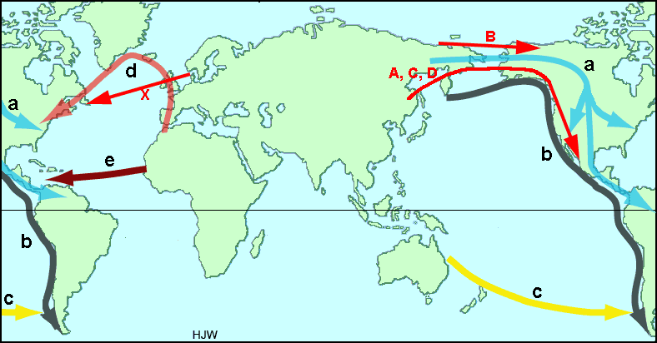
Types of Migration cont.
Cues Notes
External Migration moving to a different state, country, or continent

Slide 6
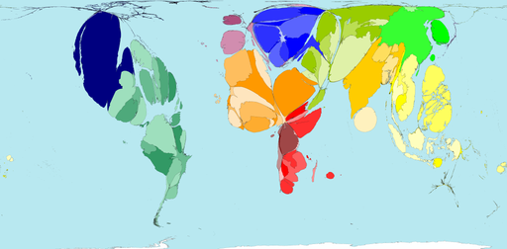
Types of Migration cont.
Cues Notes
Emigration leaving one’s country to move to another
Can see countries losing population as a result of emigration.

Slide 7
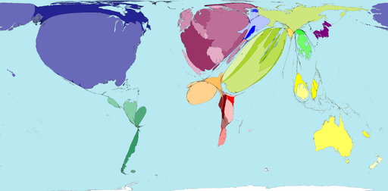
Types of Migration cont.
Cues Notes
Immigration moving to a new country
Can see countries gaining population as a result of immigration.

Slide 8
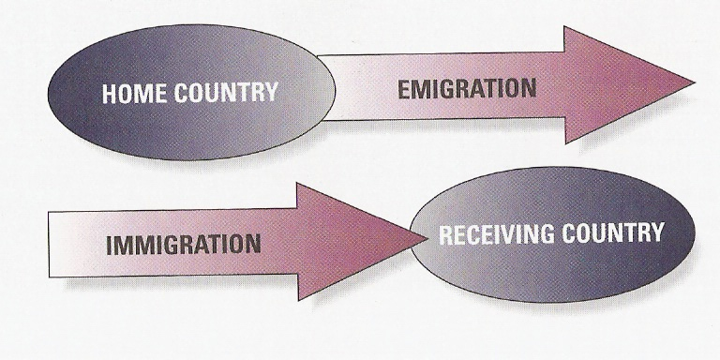

Slide 9
Types of Migration cont.
Cues Notes
Return Migration Moving back to where you came from

Slide 10
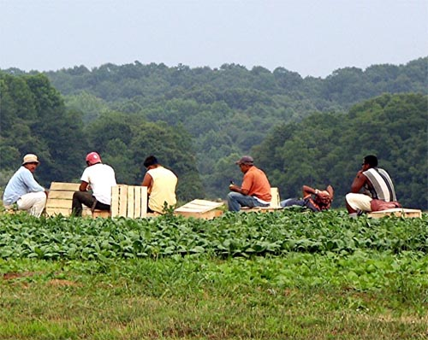
Types of Migration cont.
Cues Notes
Seasonal Migration moving with each season or in response to work or climate conditions

Slide 11
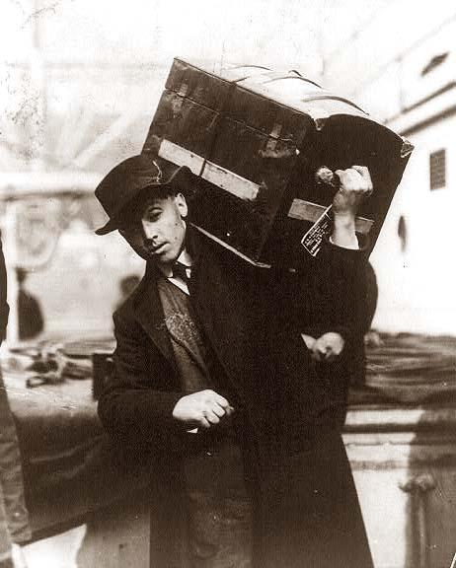
People Who Migrate
Cues Notes
Emigrant person who is leaving one country to live in another
Polish emigrant boarding ship

Slide 12
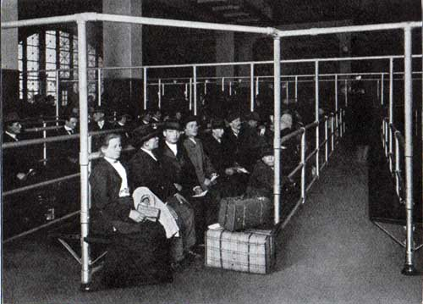
People Who Migrate cont.
Cues Notes
Immigrant a person who is entering a country from another to make a new home
Immigrants waiting for entry at Ellis Island, New York.

Slide 13
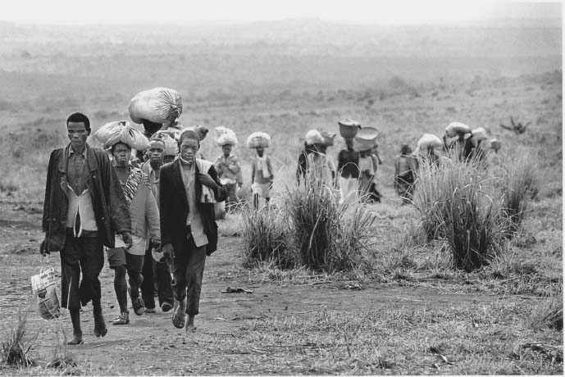
People Who Migrate cont.
Cues Notes
Refugee a person who has moved to a new country because of a problem in their former home

Slide 14
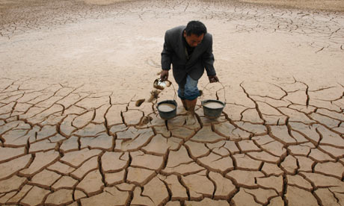
Why do people move?
Cues Notes
Push factors forces that drive people away from a place
Examples food shortages, crime, war, floods, lack of services

Slide 15
Why do people move?
Cues Notes
Pull Factors forces that draw people to immigrate to a place
Examples political stability, nicer climate, job opportunities, safety

Slide 16
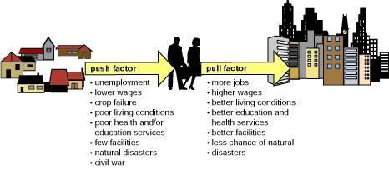
Push and Pull Factors

Slide 17
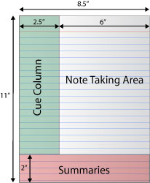
Cornell Notes Summary
Take the next five minutes to write your summary for this section of notes.

Slide 18
Work Cited
National Geographic Xpedititions. (n.d.). Migration: Reasons to move. Retrieved from http://www.nationalgeographic. com/xpeditions/lessons/09/g35/Migrati ons.html

