Slide 5
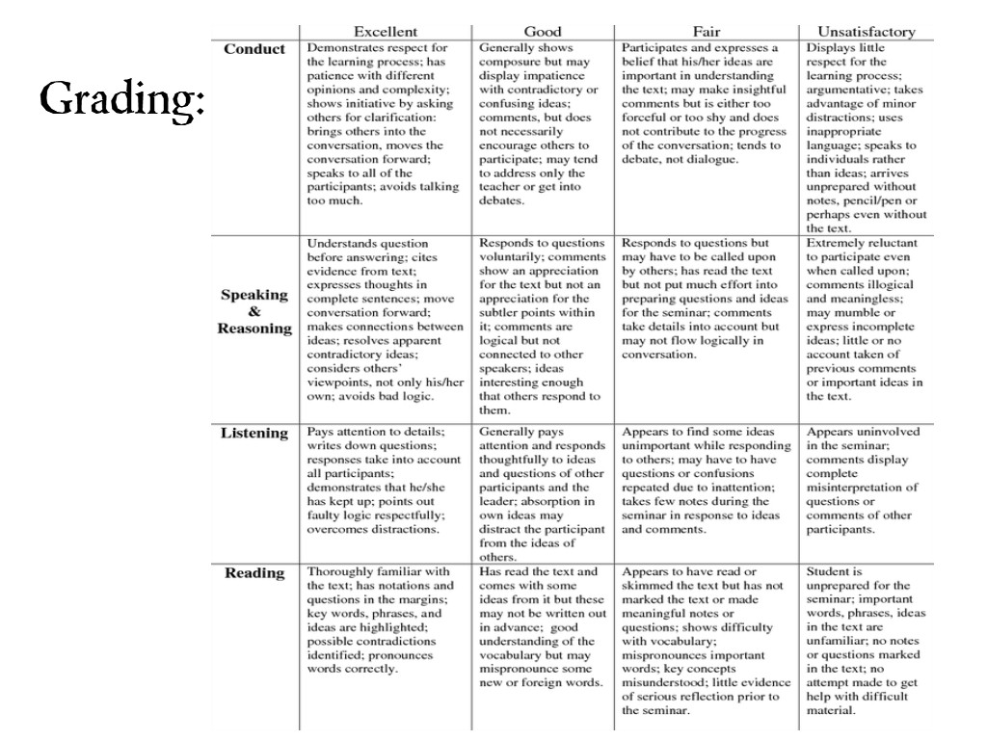

Slide 6
Works Cited
Greece Central School District. (n.d.). Socratic seminar analytic rubric. Retrieved from www.greece.k12.ny.us/files/479/SS%20Analytic %20Rubric.doc
Socratic Seminars International. (n.d.). Socratic seminar ground rules poster. Retrieved from http:// www.socraticseminars.com%2 Feducation %2Fdocuments %2FSocraticSeminarGroundRulesPoster_000.pdf
StudyGuide.org. (2009). Socratic seminars. Retrieved from http://www.studyguide.org/socratic_seminar.htm

