Slide 1
Landforms Picture Sort

Slide 2
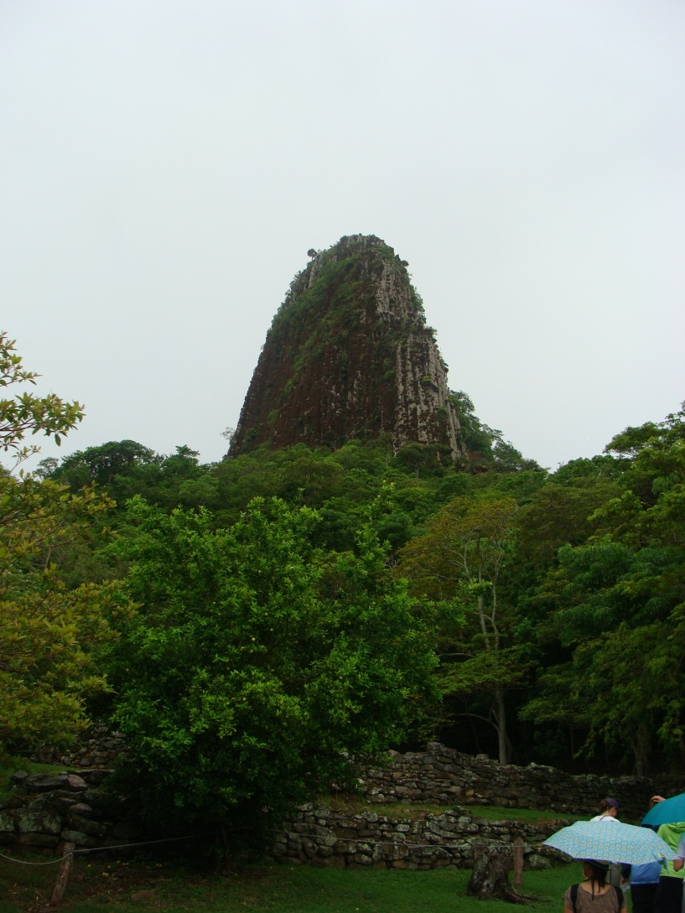
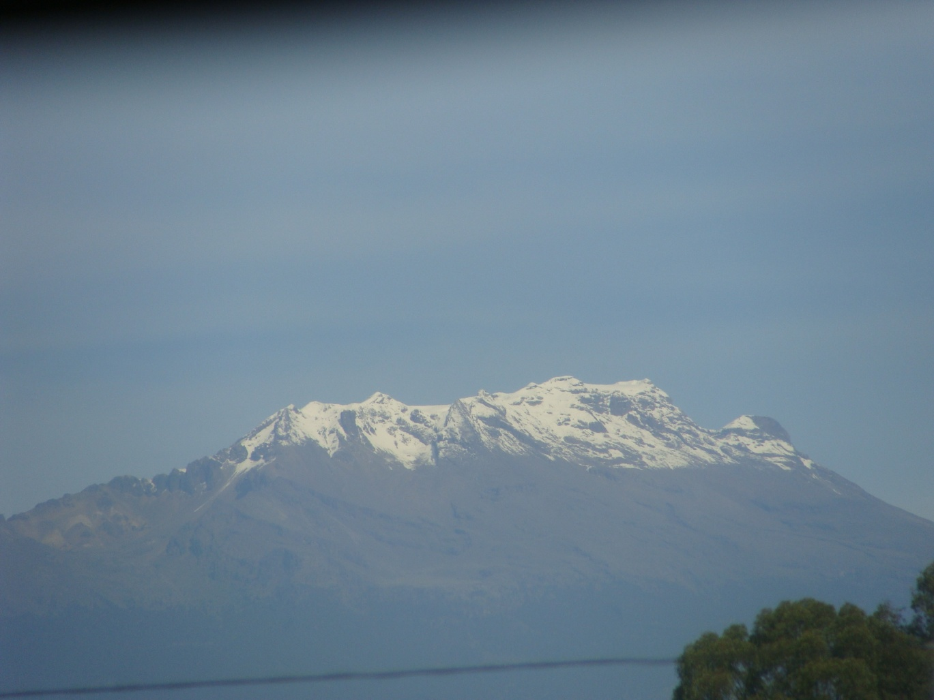
Mountains
Photo taken by author, 2012
Photo taken by author, 2012
Mexico!
Notes:
Photos taken by author, 2012.

Slide 3
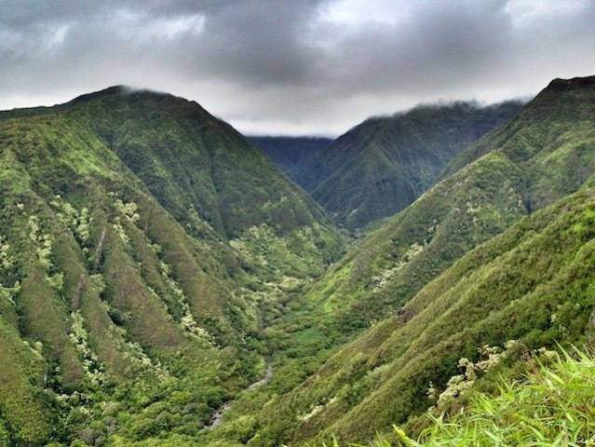
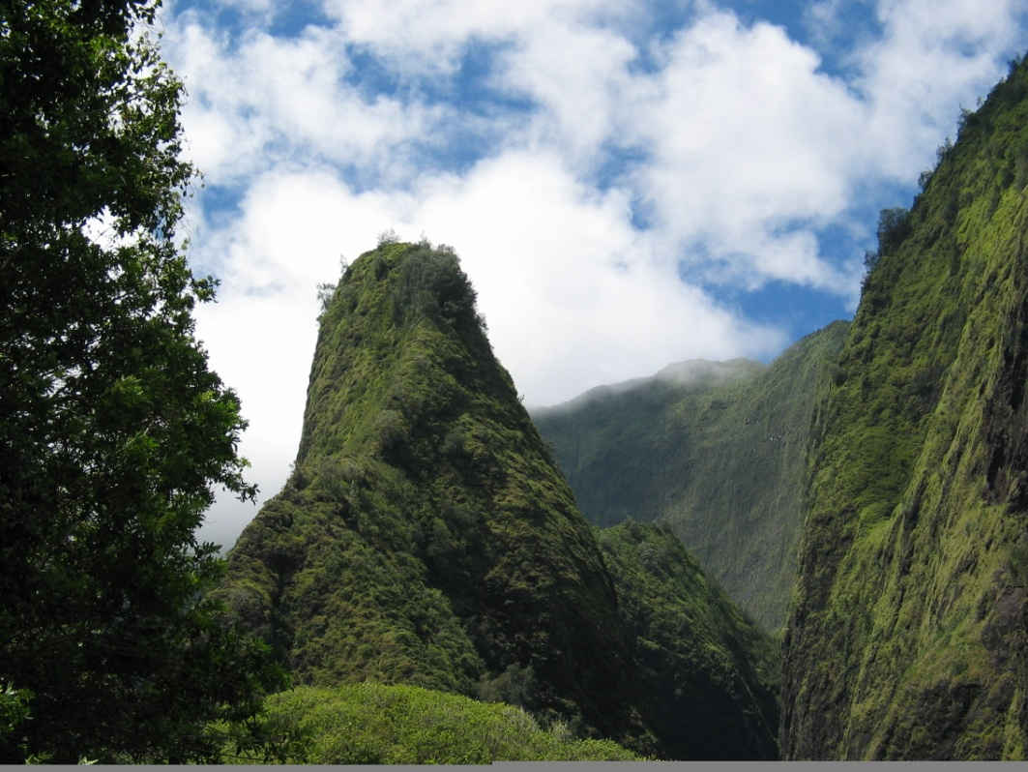
Mountains
Iao Needle, Maui by Michael Oswald, from http://en.wikipedia.org/wiki/File:Iao_Needle_MO.jpg, available under Creative Commons Attribution-Share Alike 3.0 Unported license
Photo by P. Jalbert
Hawai’i!
Notes:
Photo by P. Jalbert (right), Iao Needle, Maui by Michael Oswald, from http://en.wikipedia.org/wiki/File:Iao_Needle_MO.jpg, available under Creative Commons Attribution-Share Alike 3.0 Unported license (left)

Slide 4
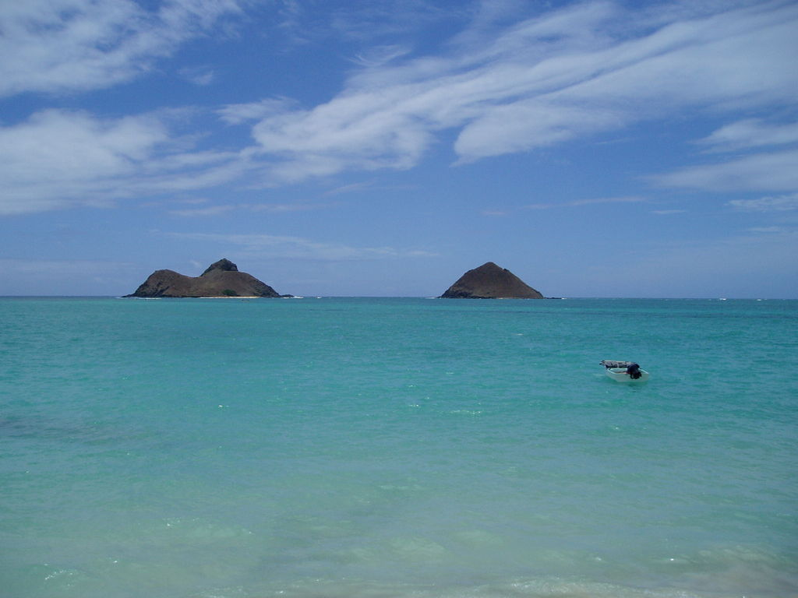
Islands
View of Na Mokulua from Lanikai Beach by Travisthurston, http://en.wikipedia.org/wiki/File:NaMokuluas.JPG, available under Creative Commons Attribution-Share Alike 3.0 Unported, 2.5 Generic, 2.0 Generic and 1.0 Generic license
Hawai’i!
Notes:
View of Na Mokulua from Lanikai Beach by Travisthurston, http://en.wikipedia.org/wiki/File:NaMokuluas.JPG, available under Creative Commons Attribution-Share Alike 3.0 Unported, 2.5 Generic, 2.0 Generic and 1.0 Generic license.

Slide 5
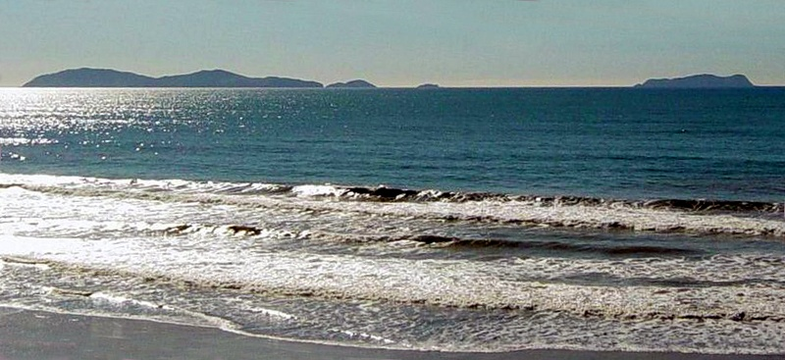
Islands
Coronado Islands, view from the shores in Tijuana, Mexico by Scalif, Intersofia from http://en.wikipedia.org/wiki/File:800px-Islas_Coronado.cc.jpg, available under Creative Commons Attribution-Share Alike 3.0 Unported license
Mexico!
Notes:
Coronado Islands, view from the shores in Tijuana, Mexico by Scalif, Intersofia from http://en.wikipedia.org/wiki/File:800px-Islas_Coronado.cc.jpg, available under Creative Commons Attribution-Share Alike 3.0 Unported license.

Slide 6
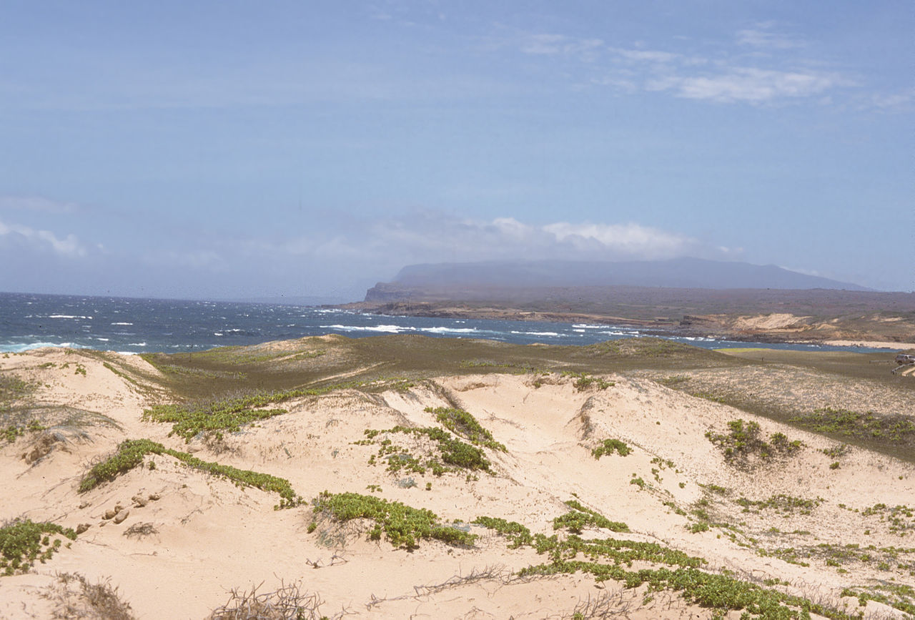
Dunes
Mo'omomi TNC Preserve with view of East Molokai and Kamakou Peak, from http://en.wikipedia.org/wiki/File:Mo%27omomi_TNC_preserve_-_Kamakou_view1.jpg, copyright holder released to public domain
Hawai’i!
Notes:
Mo'omomi TNC Preserve with view of East Molokai and Kamakou Peak, from http://en.wikipedia.org/wiki/File:Mo%27omomi_TNC_preserve_-_Kamakou_view1.jpg, copyright holder released to public domain.

Slide 7
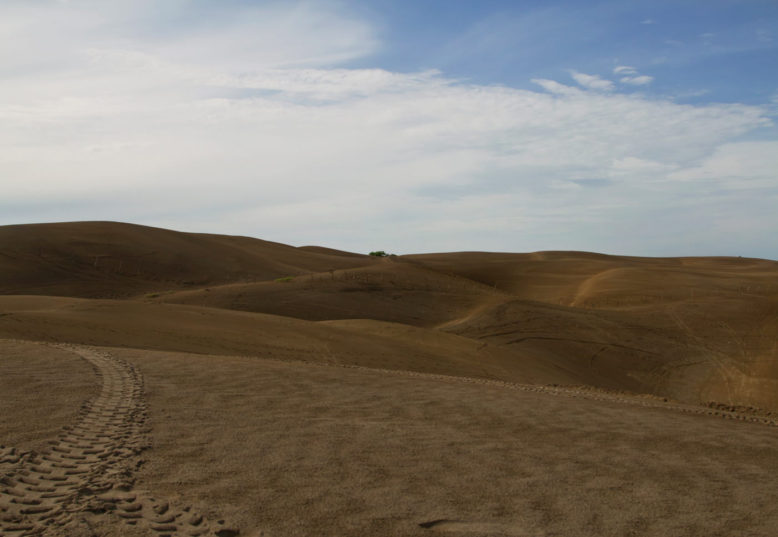
Dunes
Chachalacas by Javier Alejandro Montes D'Arce, 2012
Mexico!
Notes:
Chachalacas by Javier Alejandro Montes D'Arce, 2012

Slide 8
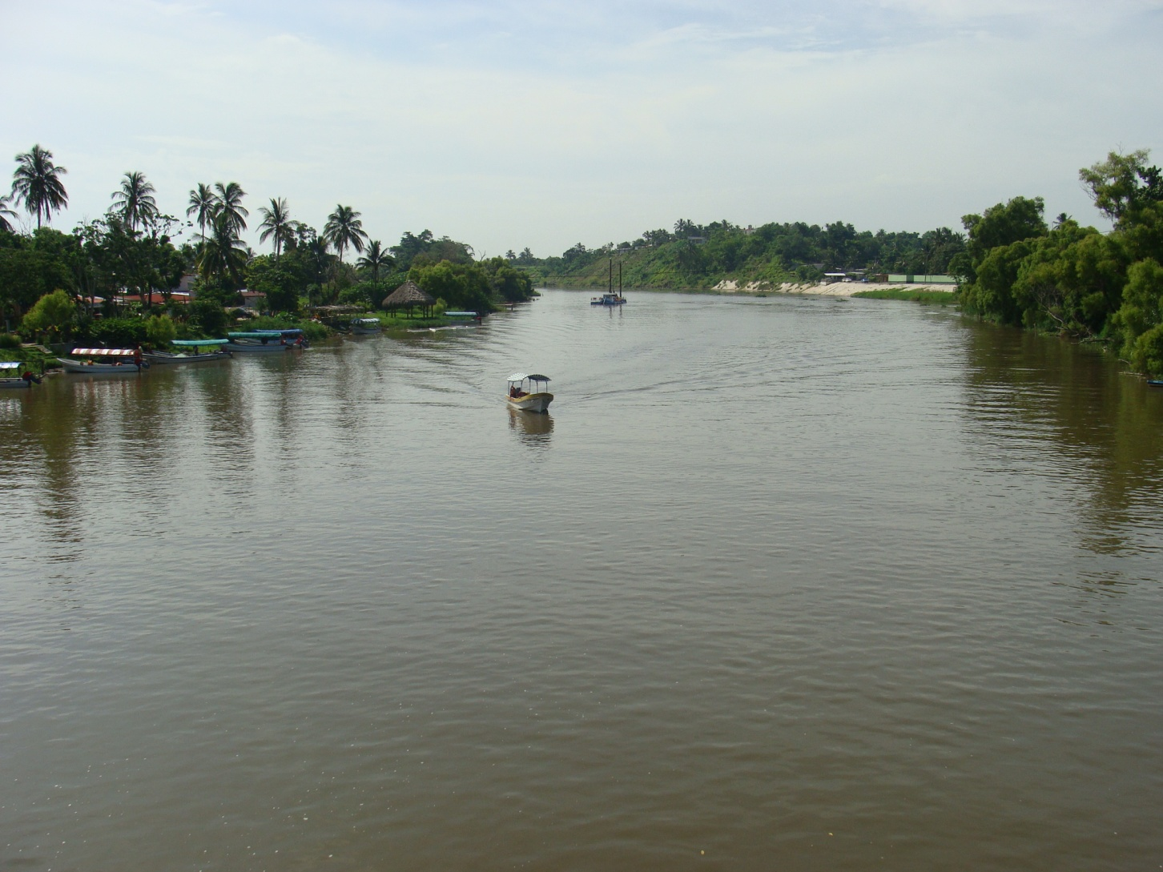
Rivers
Photo taken by author, 2012
Mexico!
Notes:
Photo taken by author.

Slide 9
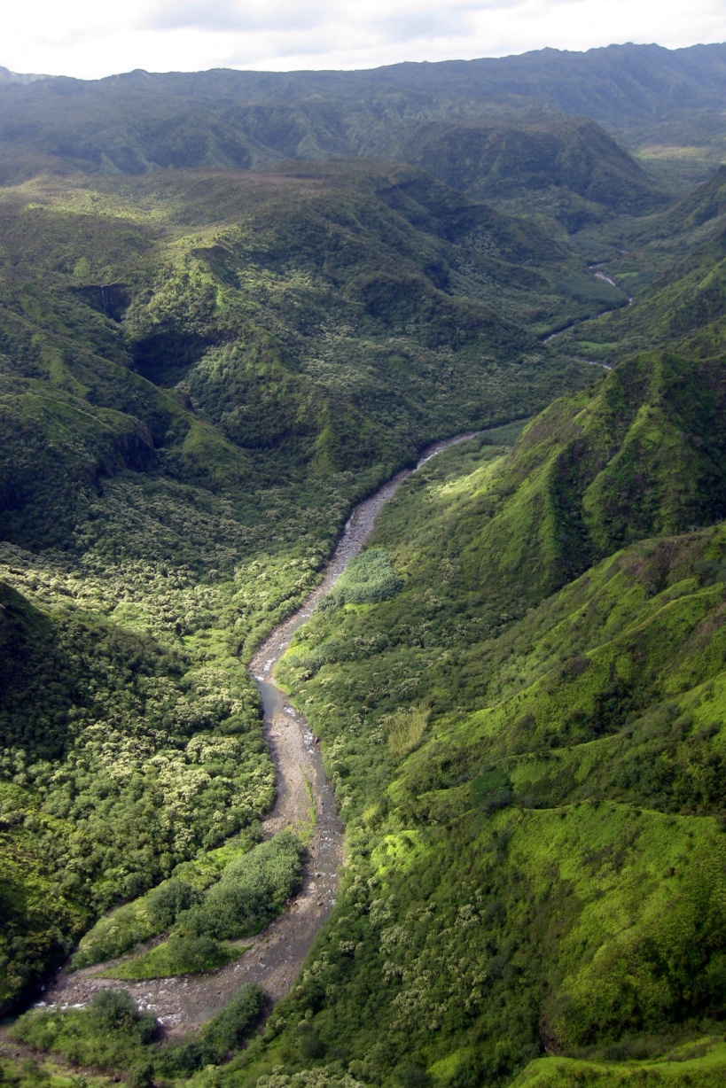
Rivers
Hawai’i!
Helicopter Tour: Hanalei Valley, by wallyg, http://www.flickr.com/photos/wallyg/4697808152/in/photostream/, available under Creative Commons Attribution-Noncommercial-No Derivative Works 2.0 Generic license.
Notes:
Helicopter Tour: Hanalei Valley, by wallyg, http://www.flickr.com/photos/wallyg/4697808152/in/photostream/, available under Creative Commons Attribution-Noncommercial-No Derivative Works 2.0 Generic license.

Slide 10
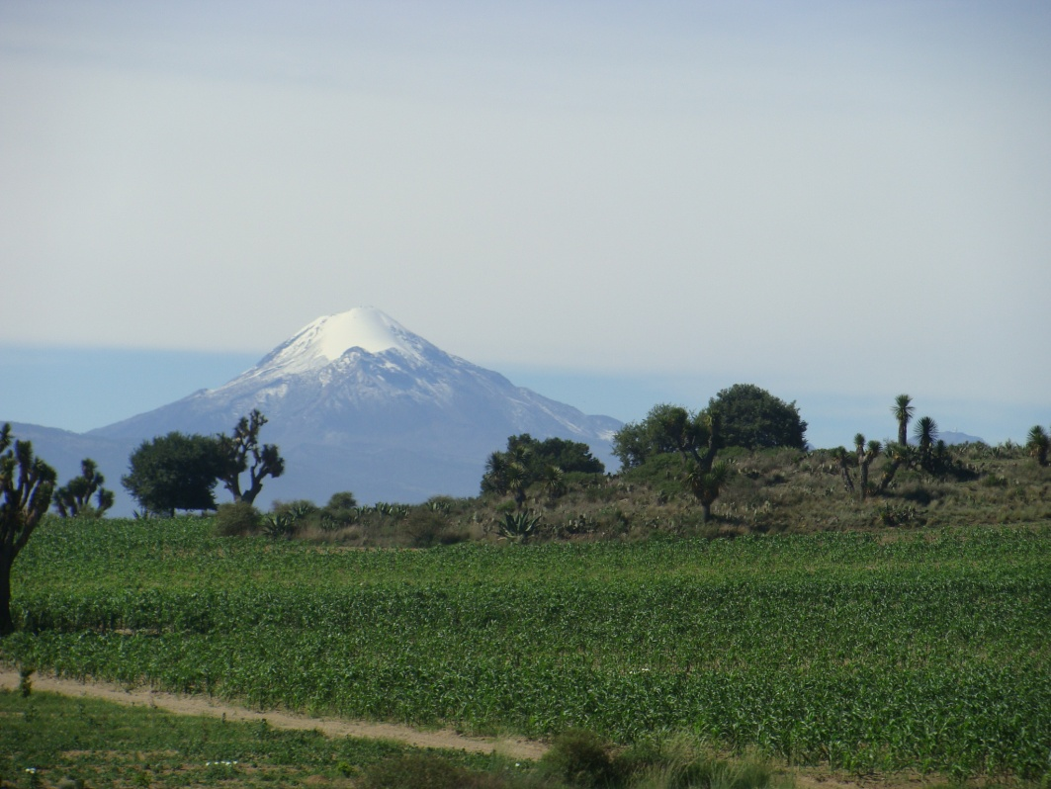
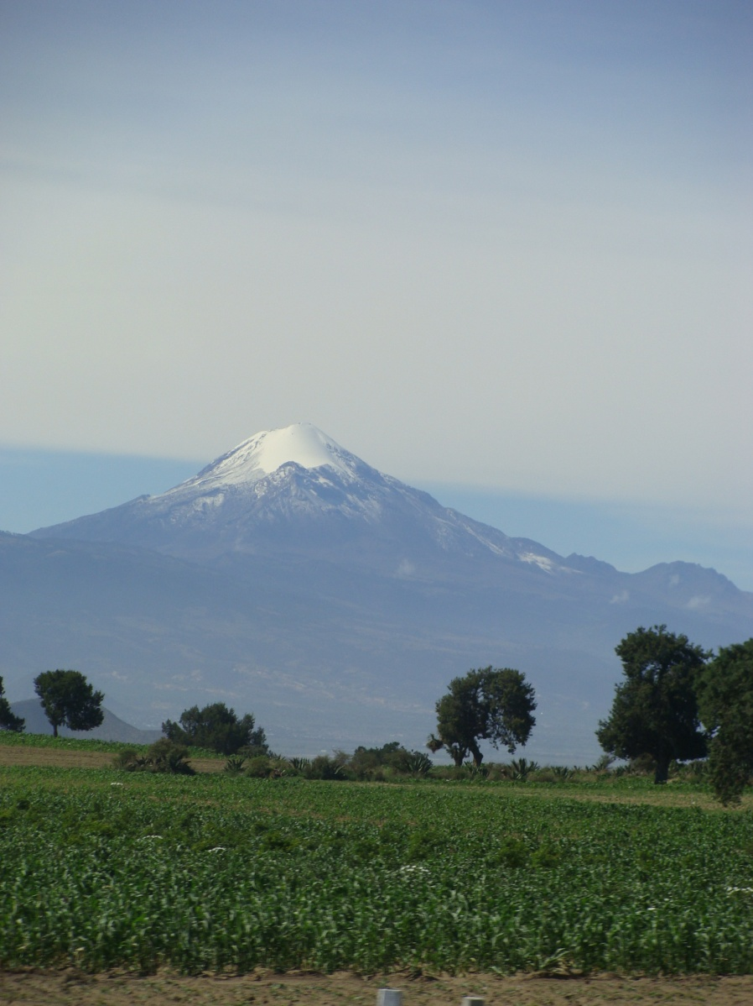
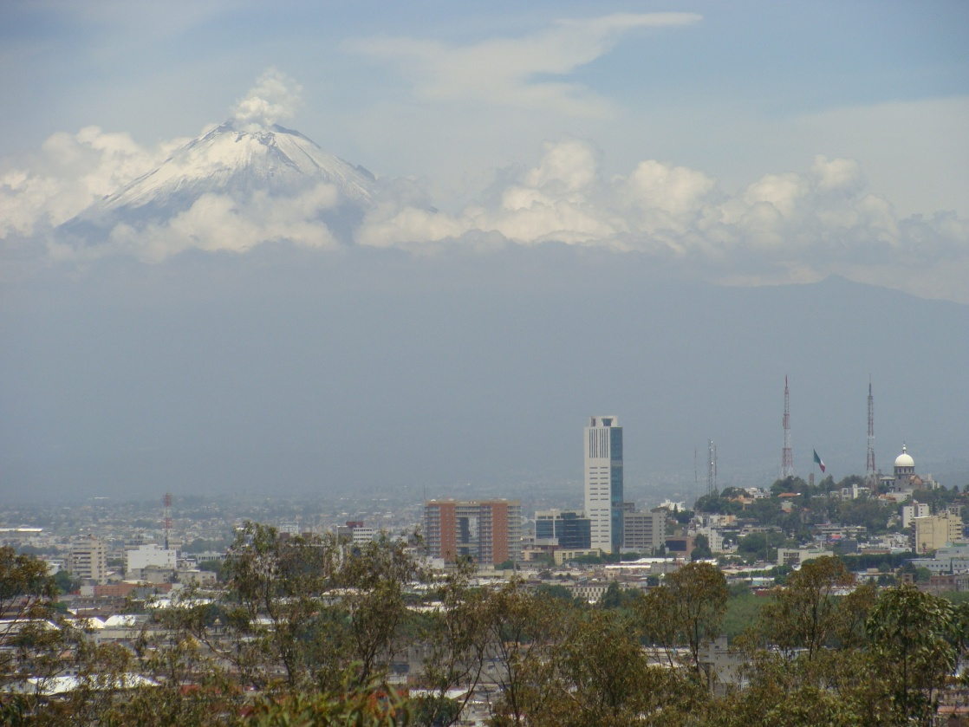
Volcanoes
Photos taken by author, 2012
Mexico!
Notes:
Photos by author

Slide 11
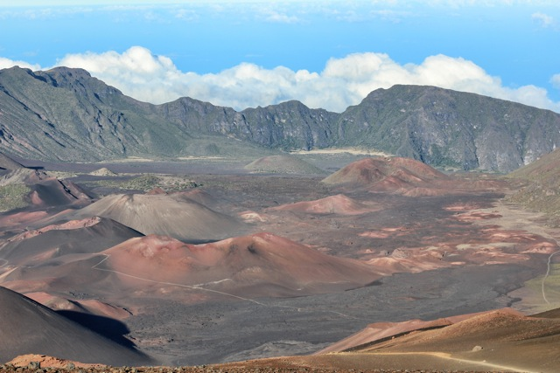
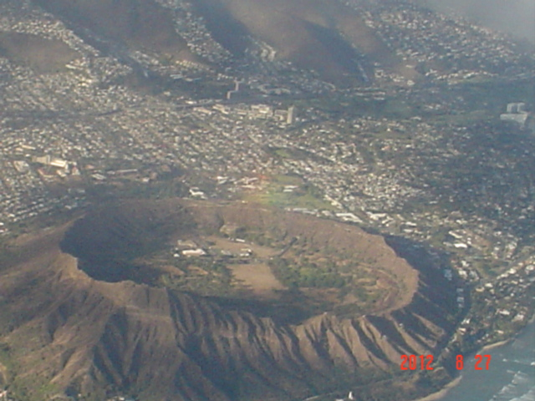
Volcanoes
Photo taken by S. Freitas, 2012
Photo taken by P. Jalbert
Hawai’i!
Notes:
Top photo taken by P. Jalbert, Bottom photo taken by S. Freitas

Slide 12
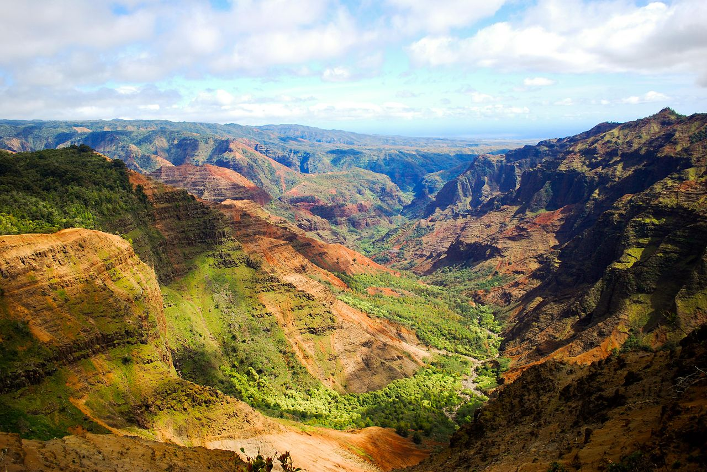
Canyons
Waimea Canyon on the island of Kauai, by Aaronbernstein, from http://en.wikipedia.org/wiki/File:Waimea_Canyon_mar_2010.jpg, available under Creative Commons Attribution-Share Alike 3.0 Unported license
Hawai’i!
Notes:
Waimea Canyon on the island of Kauai, by Aaronbernstein, from http://en.wikipedia.org/wiki/File:Waimea_Canyon_mar_2010.jpg, available under Creative Commons Attribution-Share Alike 3.0 Unported license.

Slide 13
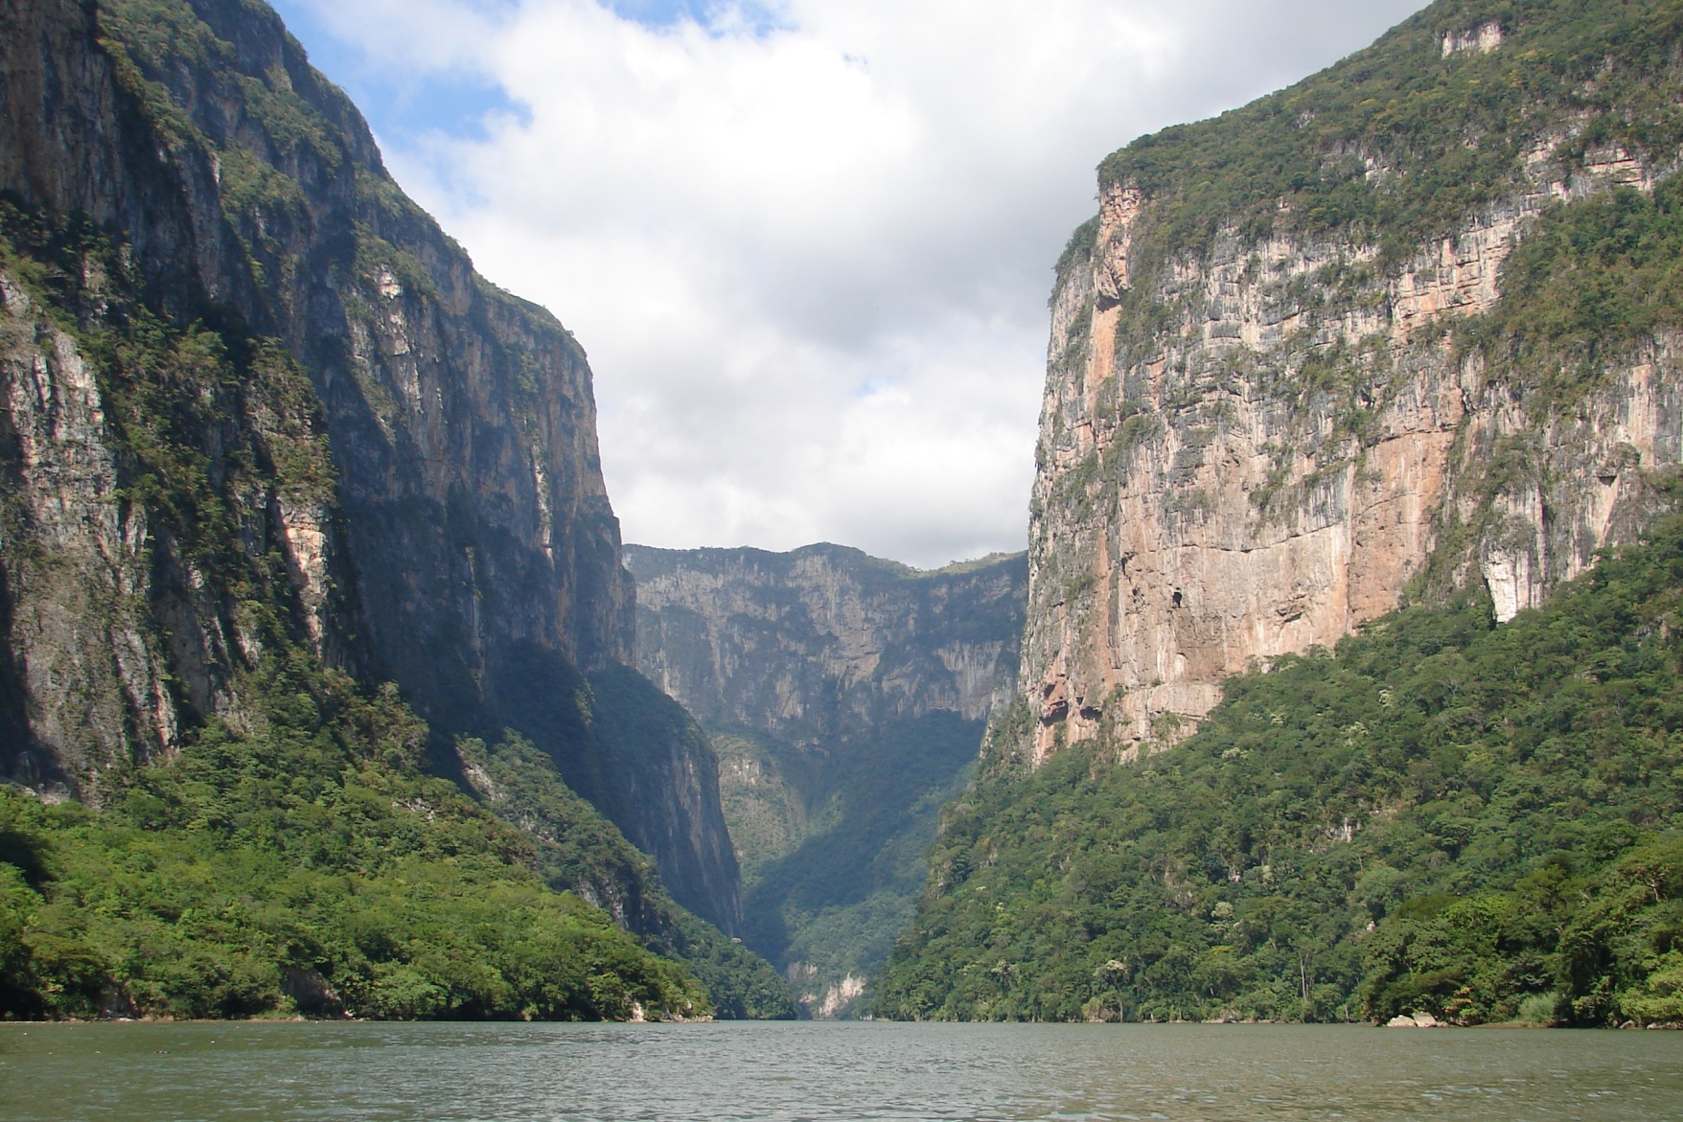
Canyons
Mexico!
Sumidero Canyon, Chiapas, by gripso_banana_prune, from http://www.flickr.com/photos/antonystanley/2086608721/, available under Creative Commons Attribution-Share Alike 2.0 Generic license
Notes:
Sumidero Canyon, Chiapas, by gripso_banana_prune, from http://www.flickr.com/photos/antonystanley/2086608721/, available under Creative Commons Attribution-Share Alike 2.0 Generic license.

Slide 14
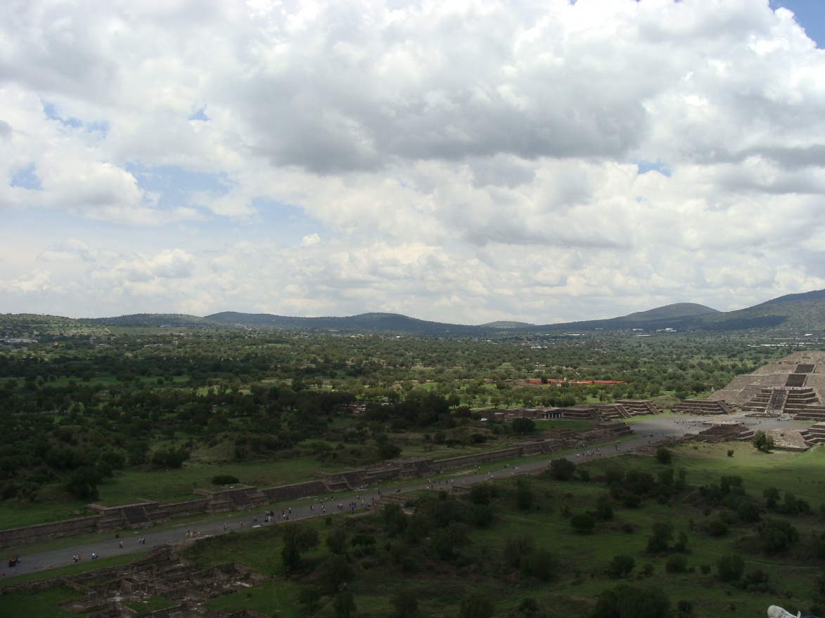
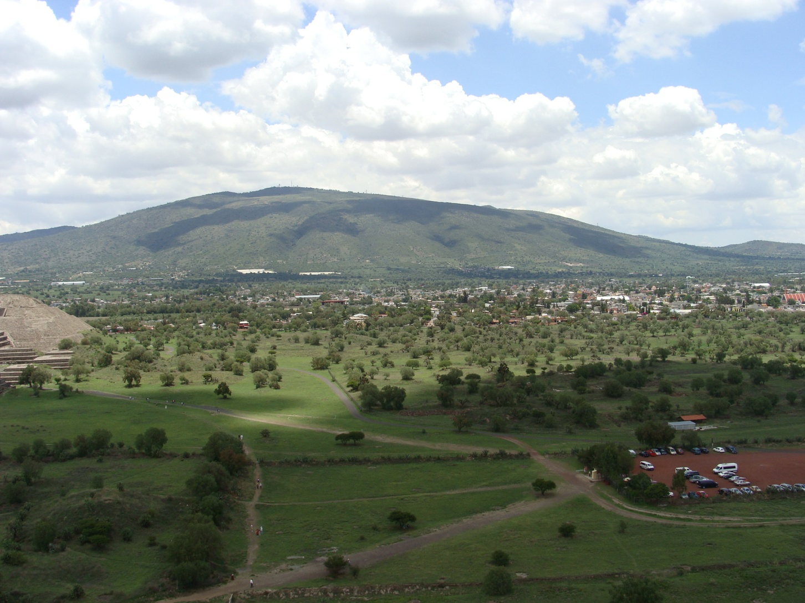
Valleys
Photo taken by author, 2012
Photo taken by author, 2012
Mexico!
Notes:
Photos taken by author

Slide 15
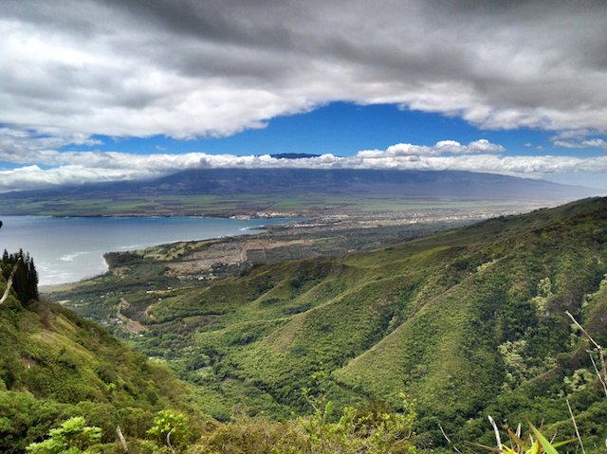
Valleys
Photo taken by P. Jalbert
Hawai’i!
Notes:
Photo by P. Jalbert

Slide 16
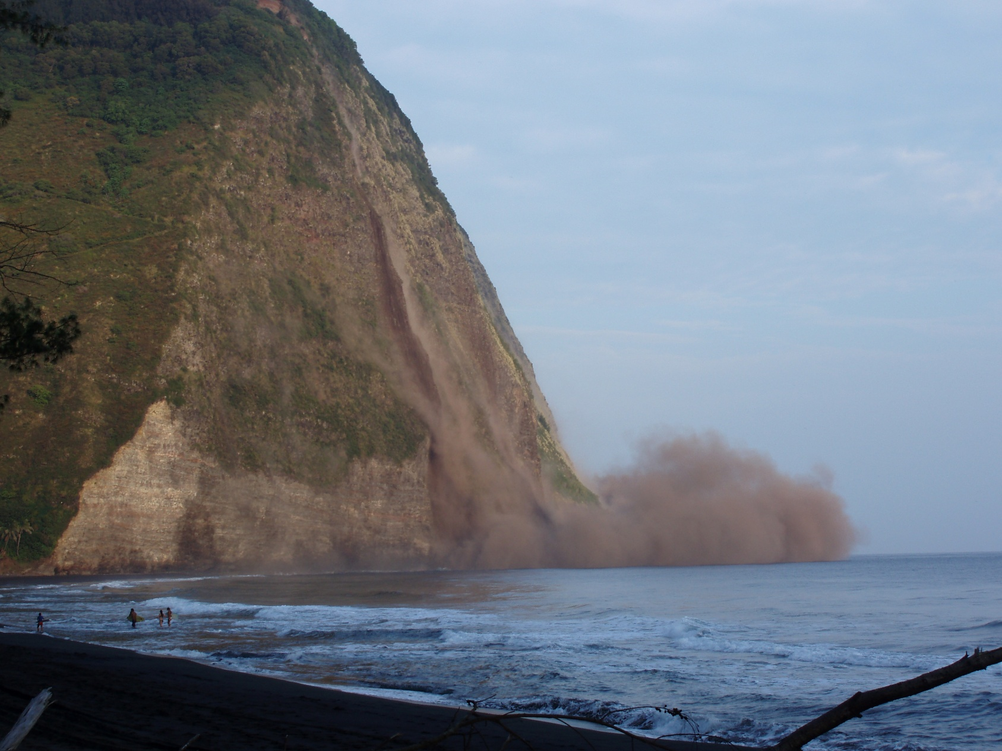
Earthquake Damage
Hawai’i!
Cliff collapsing in Waipi'o Valley, Hawai'i during the 15 October, 2006 earthquake, by MonicaSP54, from http://en.wikipedia.org/wiki/File:2006_Hawaii_earthquake.JPG, available under Creative Commons Attribution-Share Alike 2.5 Generic license
Notes:
Cliff collapsing in Waipi'o Valley, Hawai'i during the 15 October, 2006 earthquake, by MonicaSP54, from http://en.wikipedia.org/wiki/File:2006_Hawaii_earthquake.JPG, available under Creative Commons Attribution-Share Alike 2.5 Generic license.

Slide 17
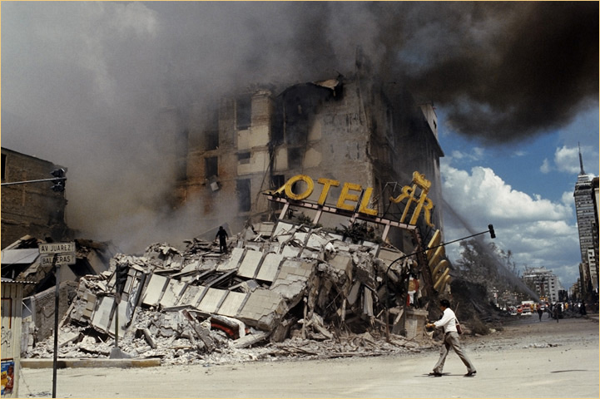
Earthquake Damage
Terremoto de 1985 en Mexico by Dan Gallard, from http://en.wikipedia.org/wiki/File:Terremoto_1985.jpg , available under Creative Commons Attribution-Share Alike 3.0 Unported license
Mexico!
Notes:
Terremoto de 1985 en Mexico by Dan Gallard, from http://en.wikipedia.org/wiki/File:Terremoto_1985.jpg , available under Creative Commons Attribution-Share Alike 3.0 Unported license

Slide 18
How did you do?
My group was able to identify each landform or land feature.
My group was able to identify most of the landforms or land features.
My group was able to identify a few of the landforms or land features.
Clip Art from Microsoft Office

Slide 19
Give yourself a grade!
As a group, fill out the Group Reflection.

