Slide 1
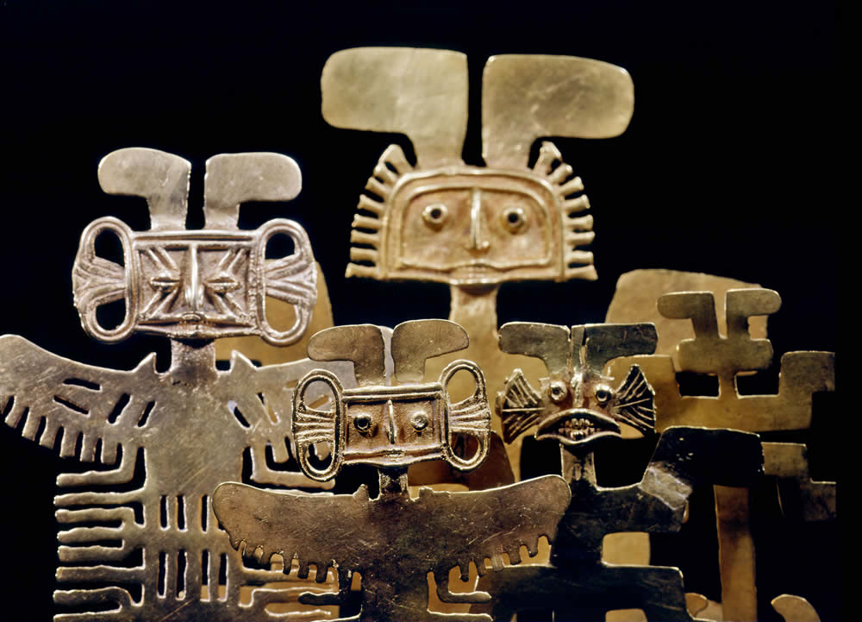
The People of Nariño

Slide 2
Location
Peoples of this region lived in the high plains of southern Colombia and northern Ecuador.

Slide 3
Subsistence
Pottery showed images of hunting, fishing and herding animals.

Slide 4
The Predecessors of the Pastos 600 to 160 A.D.
Gold and pottery objects have been found with figures of animals and humans.
Evidence that objects were made for the funerals of
different rulers.
Shamans used coca leaves in special ceremonies.
Decorated discs suspended from a cord may have been used in these special ceremonies.

Slide 5
The cultural groups that lived in the Nariño region included the Pasto, Quillacinga, Abade, and Sindagua.
There are descendants of these indigenous groups still living in this region.

Slide 6
Spirituality: Duality
One of the beliefs that was central for many of the Pre-Columbians in South America incorporated an understanding of the opposites in nature, such as sun and moon, male and female, and night and day.

Slide 7
The Pastos
Chieftanships- Ruling over the territories was maintained through cooperation enhanced through trade and intermarriage.

Slide 8
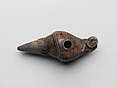
Trade
The Pastos developed trade by using people who traveled a route to obtain goods. These people had a special status and were called mindalas. Some of the trade involved items used for religious ceremonies.

Slide 9
Musical Instruments
The peoples of this region used a variety of instruments to make sound during ceremonies. They included flutes, ocarinas, trumpets, and rattles.

Slide 10
Spiritual Ceremonies
These rotating metal discs have been found in tombs. It is possible they were spun during ceremonies. They were cast and hammered from sheets of gold and copper alloy.

Slide 11
Decorated Gold Discs

Slide 12
Headdress Ornament 7th–12th Century
These headdresses might be worn as crowns or combined with cloth and basketry. They might be gold combined with copper, which was called tumbaga.

Slide 13
Shaman

Slide 14
Nose Ornament
Shamans often used nose rings to take on a different personality during spiritual ceremonies.

Slide 15
Ear Ornament Pendants

Slide 16
Ear Decorations

Slide 17
Nariño

